Slide 1


05
February 13-19, 2024
Container Types, Sorting Algorithms, Binary Search
Notes:
https://pixabay.com/en/man-reading-touchscreen-blog-791049/#_=_

Slide 2
Announcements
Project 2 is due on February 22nd at 11:59 PM
Lab 4 autograder and quiz are due on February 19th at 11:59 PM
Lab 5 handwritten is due IN LAB by February 19th. DO NOT CALL SORT()!!!
Lab 5 quiz is due on February 26th at 11:59 PM
No autograder portion (quiz is worth 15 points)
Midterm: Tuesday, March 5th from 7:00 PM to 9:00 PM
If you need an alternate time, or SSD accommodations, you must complete the alternate exam request form as soon as possible!
No labs until March 12th!

Slide 3
Agenda
Midterm Topics
Container Types
Sorting Algorithms
Binary Search
Handwritten Problem

Slide 4
Handwritten Problem Review
Notes:
Fee added these so she can click through them in her lab :)

Slide 5
Lab 4 Written Problem: Connecting Ropes
Find the minimum cost of connecting ropes:
for example, if we had seven ropes of length 1 and one rope of length 100…
we would keep on connecting the ropes of length 1 until it becomes one rope
this combined rope would have a length of 7
we then combine this rope of length 7 with the rope of length 100
notice that we connect the smallest ropes first… what is a good data structure for this?
.-----$107----.
| |
.-----$7------. |
| | |
.-$4---. .-$3-. |
| | | | |
.$2-. .$2-. .$2-. | |
| | | | | | | |
1 1 1 1 1 1 1 100
Sum: 1+1+1+1+1+1+1+100 = 107
Total Cost: 107+7+4+3+2+2+2 = 127

Slide 6

Lab 4 Written Problem: Connecting Ropes
Find the minimum cost of connecting ropes:
minimize the sum of lengths, so connect the shortest ropes ⟶ priority queue!
// calculate minimum cost required to join n ropes
int join_ropes(const vector<int>& ropes) {
priority_queue<int, vector<int>, greater<int>> pq(ropes.begin(), ropes.end());
int cost = 0;
while (pq.size() > 1) {
int rope1 = pq.top();
pq.pop();
int rope2 = pq.top();
pq.pop();
pq.push(rope1 + rope2);
cost += (rope1 + rope2);
}
return cost;
}
we want a min PQ, so we use greater<int> here
if you want to efficiently convert data in a container into a heap (PQ), consider using a range constructor
connect the two shortest ropes you have until you only have one rope left, incrementing cost by the combined lengths of the ropes along the way

Slide 7
Lab 4 Written Problem: Connecting Ropes
Find the minimum cost of connecting ropes:
minimize the sum of lengths, so connect the shortest ropes ⟶ priority queue!
// calculate minimum cost required to join n ropes
int join_ropes(const vector<int>& ropes) {
priority_queue<int, vector<int>, greater<int>> pq(ropes.begin(), ropes.end());
int cost = 0;
while (pq.size() > 1) {
int rope1 = pq.top();
pq.pop();
int rope2 = pq.top();
pq.pop();
pq.push(rope1 + rope2);
cost += (rope1 + rope2);
}
return cost;
}
Why not just use a sorted array???
we want a min PQ, so we use greater<int> here
if you want to efficiently convert data in a container into a heap (PQ), consider using a range constructor
connect the two shortest ropes you have until you only have one rope left, incrementing cost by the combined lengths of the ropes along the way

Slide 8
Lab 4 Written Problem: Connecting Ropes
Find the minimum cost of connecting ropes:
minimize the sum of lengths, so connect the shortest ropes ⟶ priority queue!
// calculate minimum cost required to join n ropes
int join_ropes(const vector<int>& ropes) {
priority_queue<int, vector<int>, greater<int>> pq(ropes.begin(), ropes.end());
int cost = 0;
while (pq.size() > 1) {
int rope1 = pq.top();
pq.pop();
int rope2 = pq.top();
pq.pop();
pq.push(rope1 + rope2);
cost += (rope1 + rope2);
}
return cost;
}
Why not just use a sorted array???
Insertion is O(n) in an array, compared to
O(log n) in a priority queue!
Heapify is O(n) while sorting is O(n log n).
we want a min PQ, so we use greater<int> here
if you want to efficiently convert data in a container into a heap (PQ), consider using a range constructor
connect the two shortest ropes you have until you only have one rope left, incrementing cost by the combined lengths of the ropes along the way

Slide 9
Midterm Topics

Slide 10
Midterm Topics to Review
(Asymptotic) Complexity and Runtime Analysis, Math Foundations
Recursion and the Master Theorem
Container Data Structures and Array-Based Containers
The Standard Template Library (STL)
Stacks, Queues, and Priority Queue ADTs
Ordered Arrays and Related Algorithms
Set Operations (Union/Intersection) and Union-Find
Elementary Sorts and Library-Implemented Sorts
Quicksort and Mergesort
Heaps and Heapsort
Linear-Time Sorting Algorithms

Slide 11
Additional Reminders
Review all your lecture and lab notes!
Understand how to do all the lab coding exercises and projects!
Check out Piazza @1137 for additional (leetcode-style) FRQ practice
Midterm topics include sorting, binary search, union-find, stacks/queues, linked list, and array
Not required for success, simply a resource that’s available
Bring a pencil, eraser, MCard, and an 8.5”x11” note sheet (both sides OK)
No calculators or other electronic devices

Slide 12
Types of Containers

Slide 13
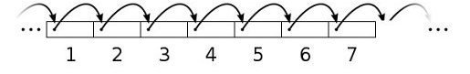
Types of Containers
Searchable
containers that support find()
searchable: vector, deque, list; not searchable: stack, queue
Sequential
allows iteration over elements in some order
sequential: vector, deque, list; not sequential: stack, queue

Slide 14
Types of Containers
Sorted
elements are stored in some pre-defined order based on a sorting criteria
does not support insert() in any location
convenient if you want to search the container
examples: map, set
Ordered
maintains current order
supports insert() at any location
insertion and deletion do not disrupt the relative ordering of other elements in the container
examples: vector, deque, list

Slide 15
Types of Containers
Ordered Containers
Sorted Containers
Data Structure | insertAfter() | operator[ ] | delete()
Array | O(n) | O(1) | O(n)
Linked-list | O(1) | O(n) | O(1)
Data Structure | find() | operator[ ] | delete()
Array | O(log n) | O(1) | O(n)
Linked-list | O(n) | O(n) | O(1)

Slide 16
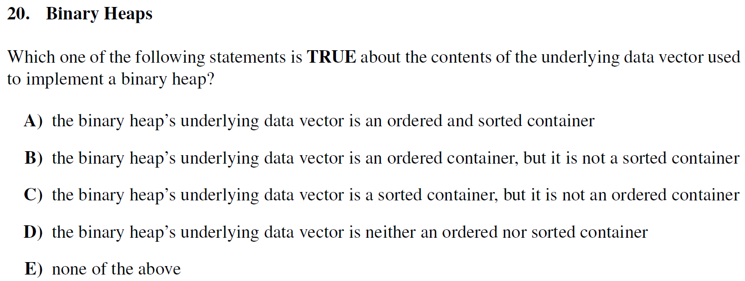
Types of Containers
Midterm Exam Question (Fall 2018)
Notes:
173/730 - 24% accuracy rate!

Slide 17
Types of Containers
Midterm Exam Question (Fall 2018)

Slide 18
Types of Containers
Why is the answer (D)?
The binary heap’s data vector is used to represent a binary tree. The relationship between the “nodes” is only that no parent is lower in priority than any of its descendants. There are multiple array representations of the exact same binary heap.
{1,2,3,4,5,6} // a valid min-heap
{1,3,2,6,5,4} // an identical heap
The variations above show that the binary heap is not sorted, as the data in the vector does not have to be in a specific order in order for the binary heap to be valid.
To show that it is not ordered, we have to determine a situation where adding an element changes the relative ordering of elements already in the heap.

Slide 19
Types of Containers
Why is the answer (D)?
Current array representation: {8,2,4}
8
2
4
8
2
4

Slide 20
Types of Containers
Why is the answer (D)?
Current array representation: {8,2,4}
Let’s add the element 9 to this binary heap!
8
2
4
8
2
4

Slide 21
Types of Containers
Why is the answer (D)?
Current array representation: {8,2,4}
Let’s add the element 9 to this binary heap!
8
2
4
9
8
2
4
9

Slide 22
Types of Containers
Why is the answer (D)?
Current array representation: {8,2,4}
Let’s add the element 9 to this binary heap!
Fix the heap invariant!
8
2
4
9
8
2
4
9

Slide 23
Types of Containers
Why is the answer (D)?
Current array representation: {8,2,4}
Let’s add the element 9 to this binary heap!
Fix the heap invariant!
8
9
4
2
8
9
4
2

Slide 24
Types of Containers
Why is the answer (D)?
Current array representation: {8,2,4}
Let’s add the element 9 to this binary heap!
Fix the heap invariant!
9
8
4
2
9
8
4
2

Slide 25
Types of Containers
Why is the answer (D)?
Current array representation: {8,2,4}
Let’s add the element 9 to this binary heap!
Fix the heap invariant!
New array representation: {9,8,4,2}
9
8
4
2
9
8
4
2

Slide 26
Types of Containers
Why is the answer (D)?
Current array representation: {8,2,4}
Let’s add the element 9 to this binary heap!
Fix the heap invariant!
New array representation: {9,8,4,2}
Notice how adding 9 to this binary heap changed the relative ordering of the other elements! Before the insertion, 2 was before 4 in the array. However, after 9 was added, 2 is now after 4 in the array! This shows that the binary heap is not ordered.
9
8
4
2
9
8
4
2

Slide 27
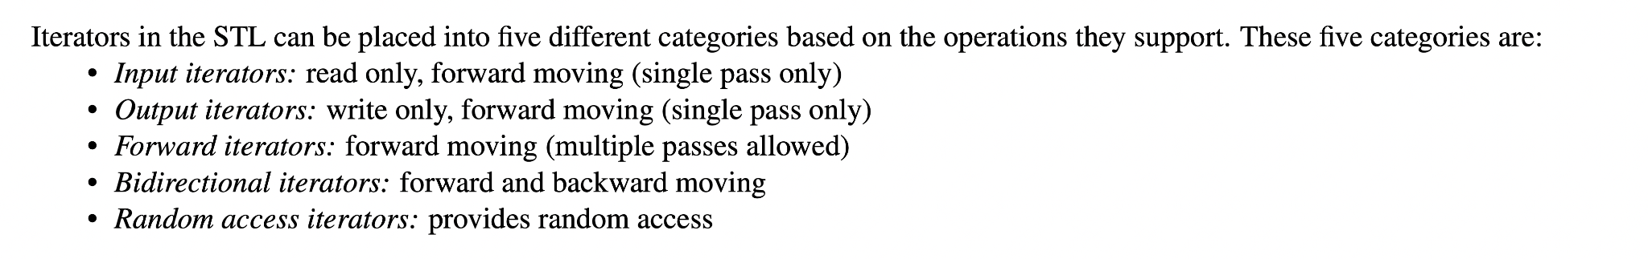
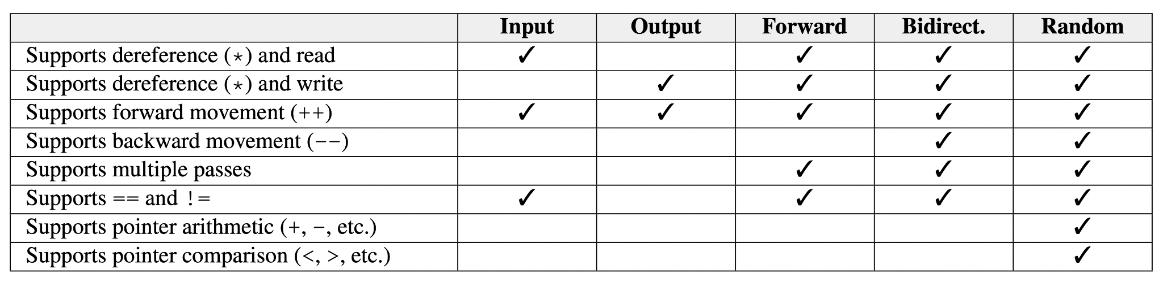
Types of Iterators
Understand the differences between different types of iterators
Further reading here: https://ajzhou.gitlab.io/eecs281/notes/chapter11/
Notes:
PUT THIS ON YOUR NOTE SHEET!!!

Slide 28
Sorting Algorithms

Slide 29
Sorting Algorithms
What to consider?
time complexity
space complexity
recursion
is it tail recursive?
if not, what is the stack depth?
stability
does it preserve the original order of elements that are equal?
adaptability
does it perform optimizations based on the order the elements are already in?

Slide 30
Overview of Sorts
Elementary sorts:
bubble sort
selection sort
insertion sort
More advanced sorts:
mergesort
quicksort
heapsort
counting sort
The following website is a great resource for visualizing these sorts!
https://visualgo.net/en

Slide 31

Bubble Sort
If you’re ever asked a sorting question during an interview...

Slide 32
Bubble Sort

Slide 33
Bubble Sort
Characteristics of bubble sort:
Not used in practice because it is inefficient for large datasets.
Algorithm: Repeatedly step through list to be sorted, comparing each pair of adjacent items and swapping if they are in the wrong order. Each time pass through a smaller section of the list until no more swaps are needed.
Stable because swaps only happen for elements with different values.
Adaptive bubble sort accomplishes best-case Ω(n) runtime: keep a boolean “swap” flag to indicate if any swaps were made during each pass of the array - if not, then the array is already sorted!
Best Case | Average Case | Worst Case | Memory | Stable?
Ω(n) | Θ(n²) | O(n²) | O(1) | Yes

Slide 34








Bubble Sort
Bubble sort in action:

Slide 35



Bubble Sort
Bubble sort in action:

Slide 36
Bubble Sort
Bubble sort in action:

Slide 37

Bubble Sort
Bubble sort in action:

Slide 38

Bubble Sort
Bubble sort in action:

Slide 39
Bubble Sort
Bubble sort in action:

Slide 40

Bubble Sort
Bubble sort in action:

Slide 41
Bubble Sort
Bubble sort in action:

Slide 42

Bubble Sort
Bubble sort in action:

Slide 43
Bubble Sort
Bubble sort in action:

Slide 44

Bubble Sort
Bubble sort in action:

Slide 45
Bubble Sort
Bubble sort in action:

Slide 46

Bubble Sort
Bubble sort in action:

Slide 47

Bubble Sort
Bubble sort in action:
in this version of bubble sort, larger elements “bubble” to the top!

Slide 48
Bubble Sort
Bubble sort in action:

Slide 49
Bubble Sort
Bubble sort in action:

Slide 50
Bubble Sort
Bubble sort in action:

Slide 51
Bubble Sort
Bubble sort in action:

Slide 52
Bubble Sort
Bubble sort in action:

Slide 53
Bubble Sort
Bubble sort in action:

Slide 54
Bubble Sort
Bubble sort in action:

Slide 55
Bubble Sort
Bubble sort in action:

Slide 56
Bubble Sort
Bubble sort in action:

Slide 57
Bubble Sort
Bubble sort in action:

Slide 58

Bubble Sort
Bubble sort in action:

Slide 59
Bubble Sort
Bubble sort in action:

Slide 60
Bubble Sort
Bubble sort in action:

Slide 61
Bubble Sort
Bubble sort in action:

Slide 62
Bubble Sort
Bubble sort in action:

Slide 63
Bubble Sort
Bubble sort in action:
Notes:
Stability can be shown here

Slide 64
Bubble Sort
Bubble sort in action:

Slide 65
Bubble Sort
Bubble sort in action:

Slide 66
Bubble Sort
Bubble sort in action:

Slide 67

Bubble Sort
Bubble sort in action:
notice that the second 53 reached the end before the first 53… this is because bubble sort is stable!

Slide 68
Bubble Sort
Bubble sort in action:

Slide 69
Bubble Sort
Bubble sort in action:

Slide 70
Bubble Sort
Bubble sort in action:

Slide 71
Bubble Sort
Bubble sort in action:

Slide 72
Bubble Sort
Bubble sort in action:

Slide 73
Bubble Sort
Bubble sort in action:

Slide 74

Bubble Sort
Bubble sort in action:

Slide 75
Bubble Sort
Bubble sort in action:

Slide 76
Bubble Sort
Bubble sort in action:

Slide 77
Bubble Sort
Bubble sort in action:

Slide 78
Bubble Sort
Bubble sort in action:

Slide 79
Bubble Sort
Bubble sort in action:

Slide 80

Bubble Sort
Bubble sort in action:

Slide 81
Bubble Sort
Bubble sort in action:

Slide 82
Bubble Sort
Bubble sort in action:

Slide 83
Bubble Sort
Bubble sort in action:

Slide 84
Bubble Sort
Bubble sort in action:

Slide 85

Bubble Sort
Bubble sort in action:

Slide 86
Bubble Sort
Bubble sort in action:

Slide 87
Bubble Sort
Bubble sort in action:

Slide 88

Bubble Sort
Bubble sort in action:

Slide 89

Bubble Sort
Bubble sort in action:

Slide 90
Selection Sort

Slide 91
Selection Sort
Characteristics of selection sort:
Good when auxiliary memory is limited.
Algorithm: divide input list into sub-list of sorted items and sub-list of unsorted items. Add the smallest non-selected item to the back of the sorted portion (usually by swapping by whatever was there). This increases the sorted portion’s size. Repeat until the whole array is sorted.
in other words, find the smallest element in the list and swap with the first position, find the second smallest element and swap with second position…
Additional memory can make the sort stable (break ties using original index)
Best Case | Average Case | Worst Case | Memory | Stable?
Ω(n²) | Θ(n²) | O(n²) | O(1) | No*
Notes:
Example to show that it’s not stable: [4, 3, 4, 2, 1]

Slide 92
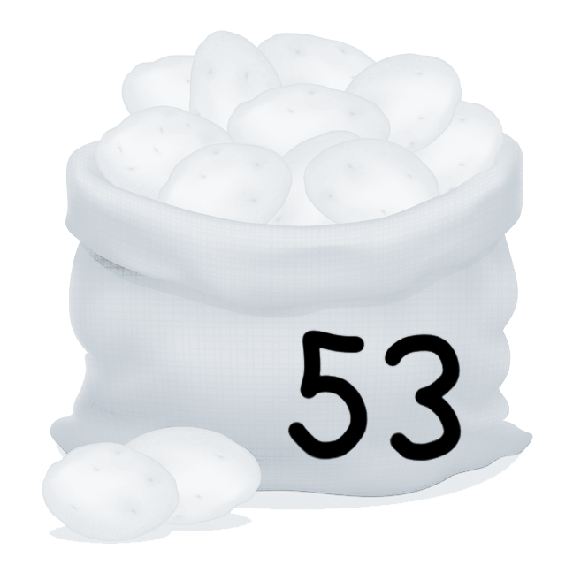
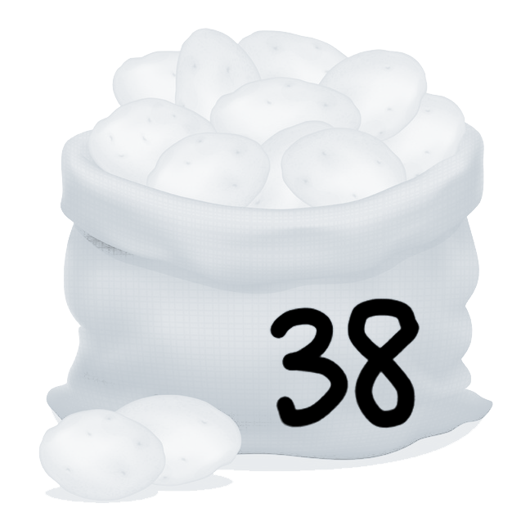
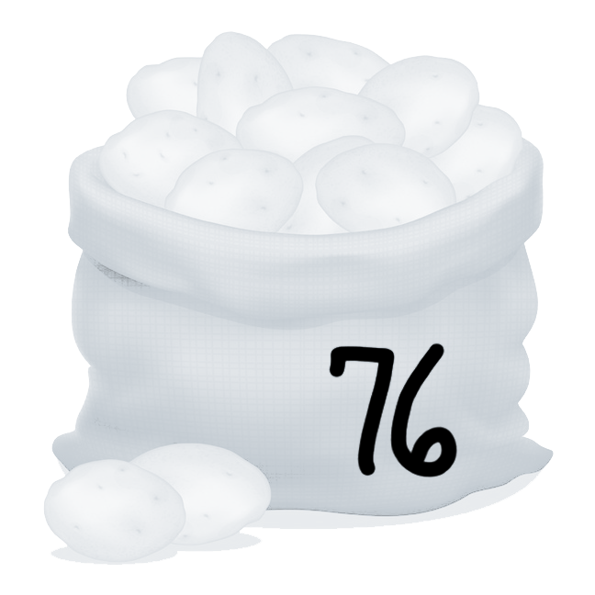
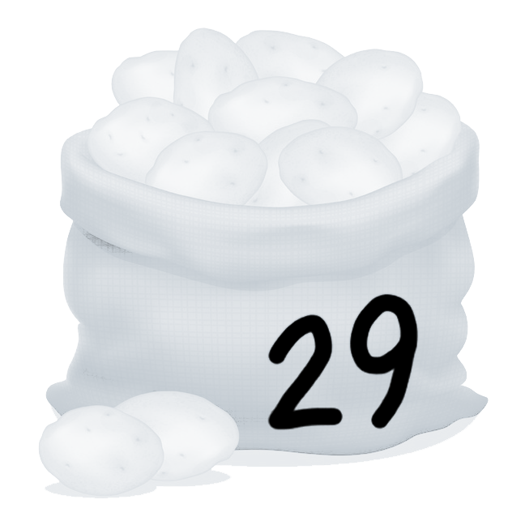
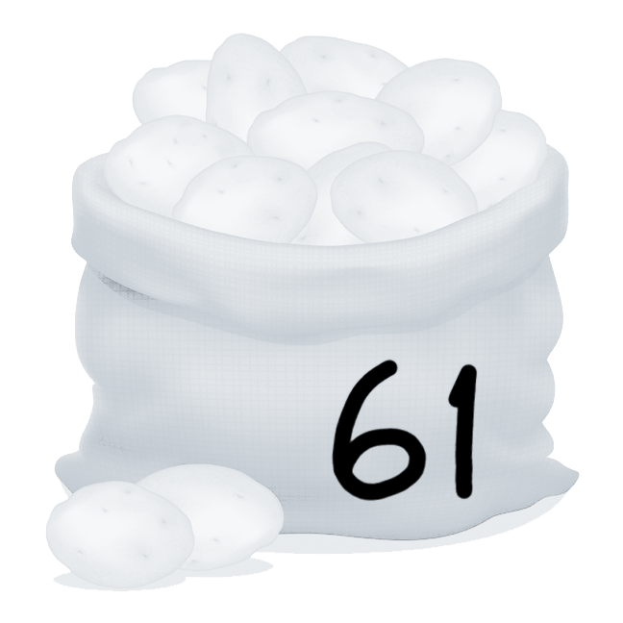
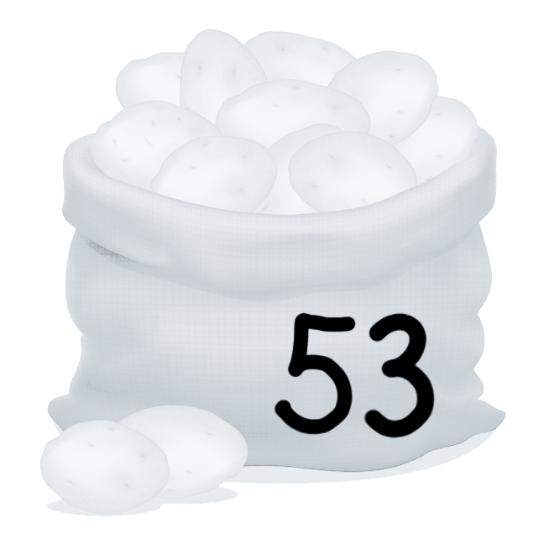
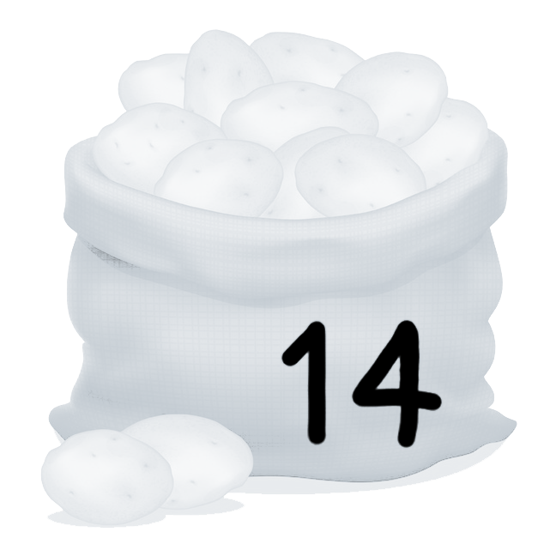
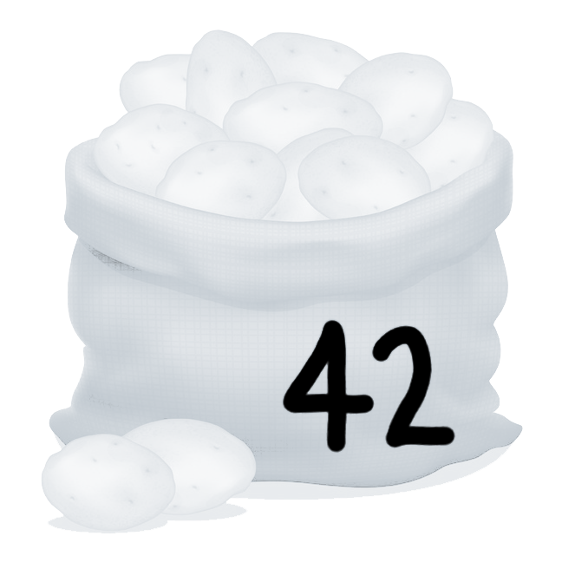
Selection Sort
Selection sort in action:

Slide 93
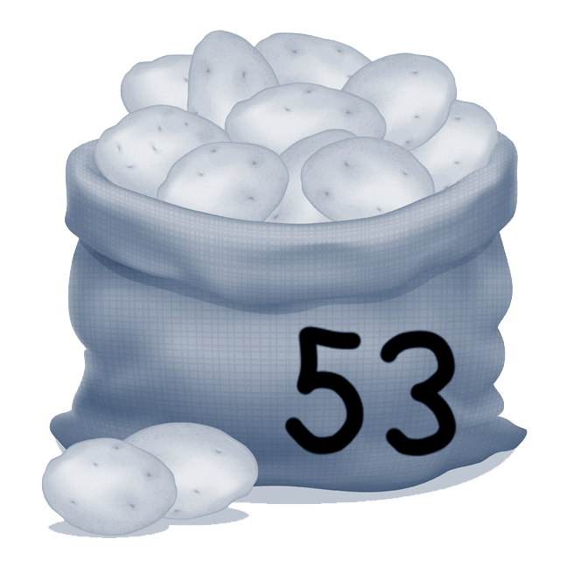
Selection Sort
Selection sort in action:
the gray shading indicates the minimum value seen so far for each traversal

Slide 94
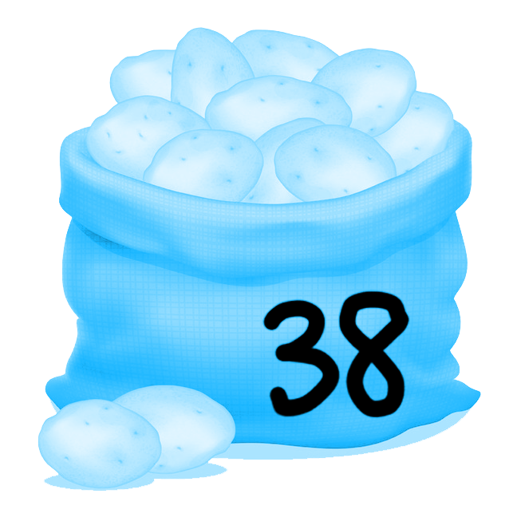
Selection Sort
Selection sort in action:

Slide 95
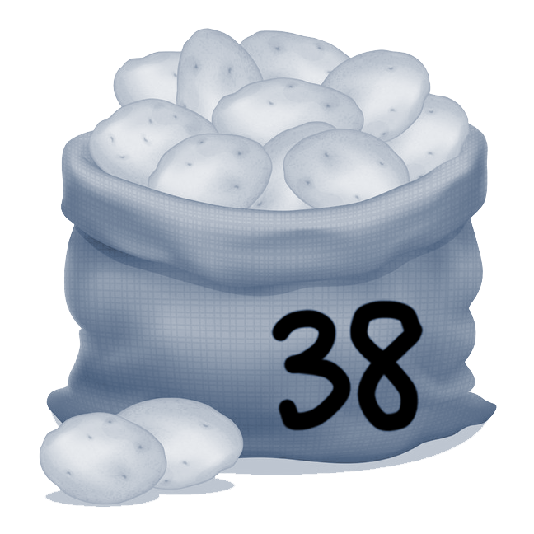
Selection Sort
Selection sort in action:

Slide 96
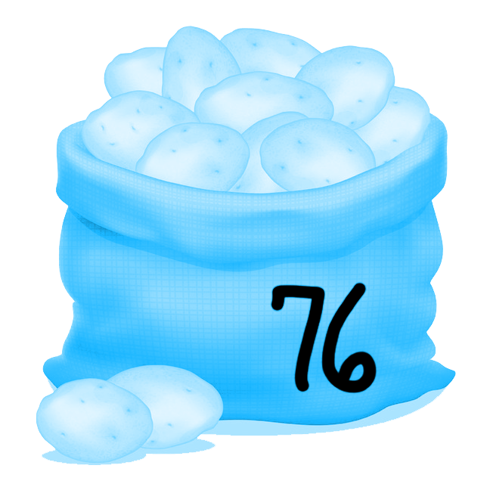
Selection Sort
Selection sort in action:

Slide 97

Selection Sort
Selection sort in action:

Slide 98
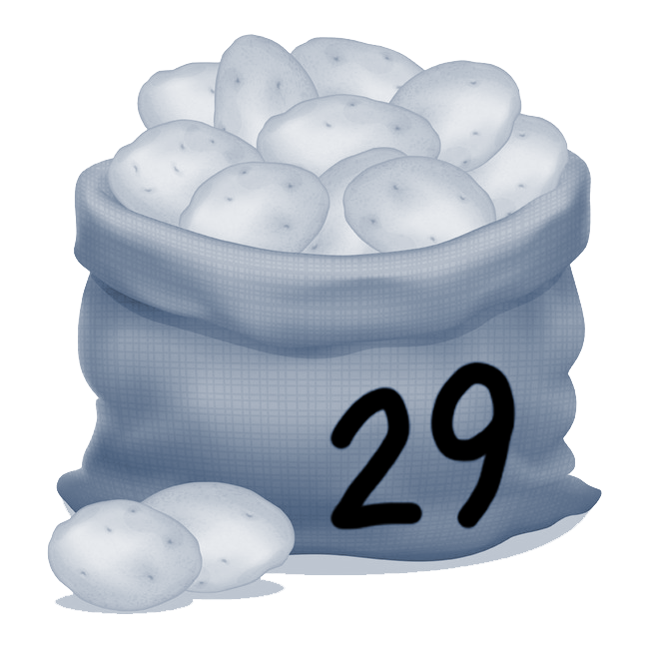
Selection Sort
Selection sort in action:

Slide 99
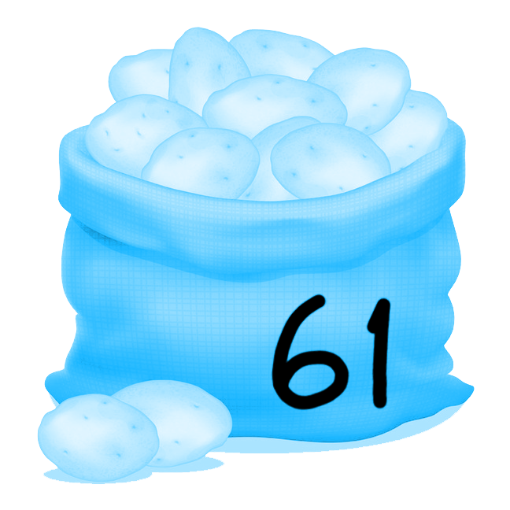
Selection Sort
Selection sort in action:

Slide 100
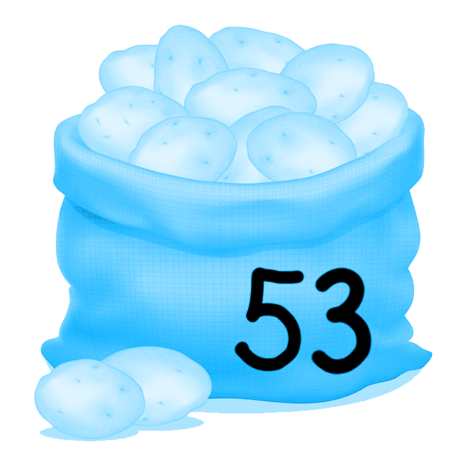
Selection Sort
Selection sort in action:

Slide 101
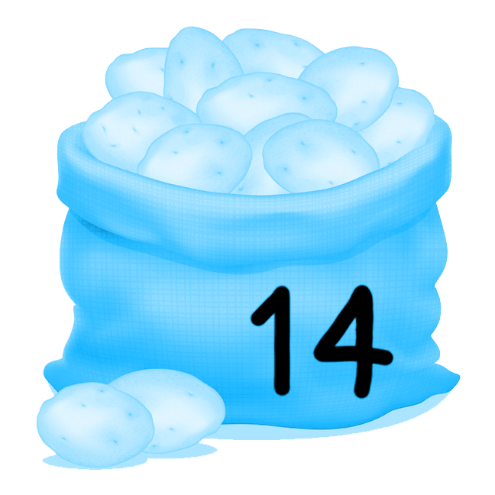
Selection Sort
Selection sort in action:

Slide 102
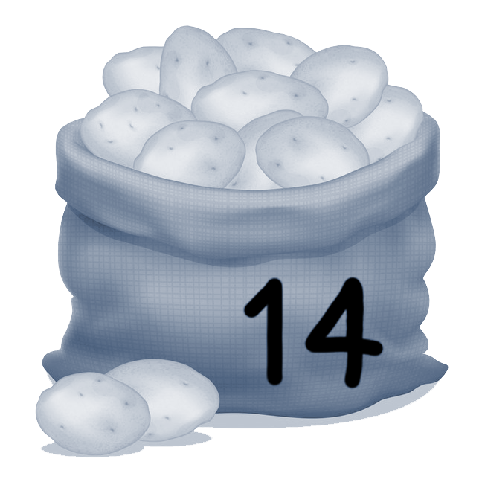
Selection Sort
Selection sort in action:

Slide 103
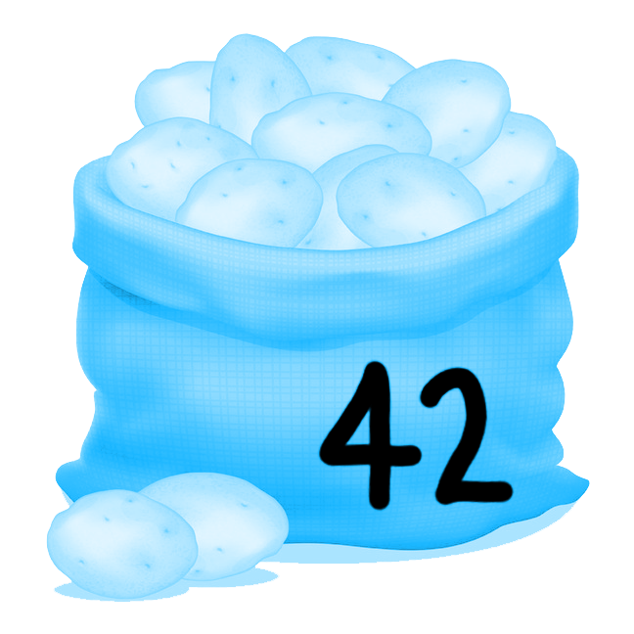
Selection Sort
Selection sort in action:

Slide 104
Selection Sort
Selection sort in action:
find smallest and send to first index, find second smallest and send to second index, etc.

Slide 105
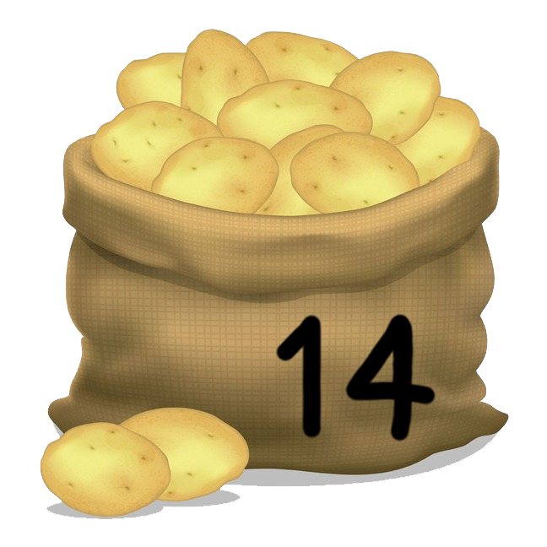
Selection Sort
Selection sort in action:

Slide 106
Selection Sort
Selection sort in action:

Slide 107
Selection Sort
Selection sort in action:

Slide 108
Selection Sort
Selection sort in action:

Slide 109
Selection Sort
Selection sort in action:

Slide 110
Selection Sort
Selection sort in action:

Slide 111
Selection Sort
Selection sort in action:

Slide 112
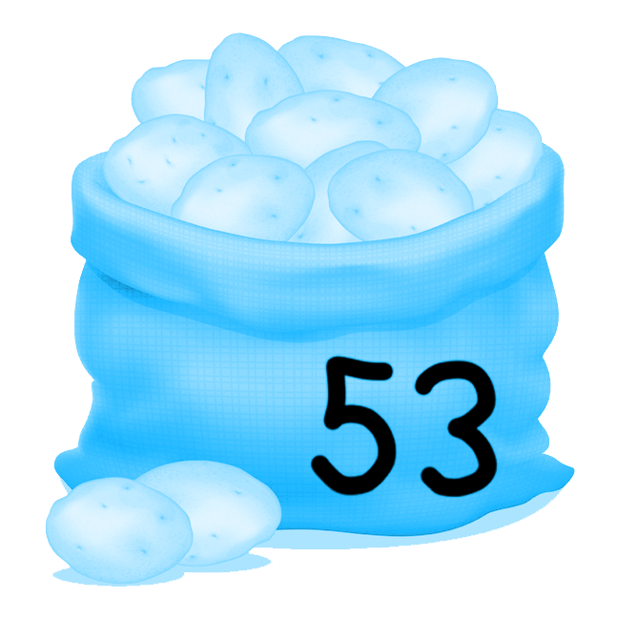
Selection Sort
Selection sort in action:

Slide 113
Selection Sort
Selection sort in action:

Slide 114
Selection Sort
Selection sort in action:

Slide 115
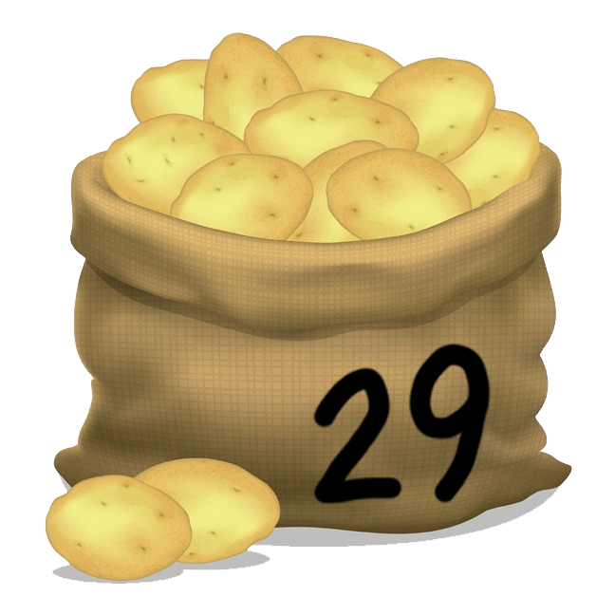
Selection Sort
Selection sort in action:

Slide 116
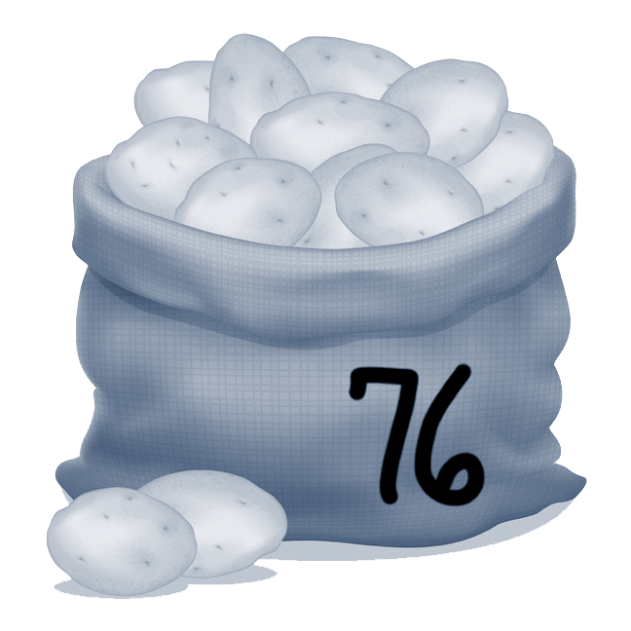
Selection Sort
Selection sort in action:

Slide 117
Selection Sort
Selection sort in action:

Slide 118
Selection Sort
Selection sort in action:

Slide 119
Selection Sort
Selection sort in action:

Slide 120
Selection Sort
Selection sort in action:

Slide 121
Selection Sort
Selection sort in action:

Slide 122
Selection Sort
Selection sort in action:

Slide 123
Selection Sort
Selection sort in action:

Slide 124
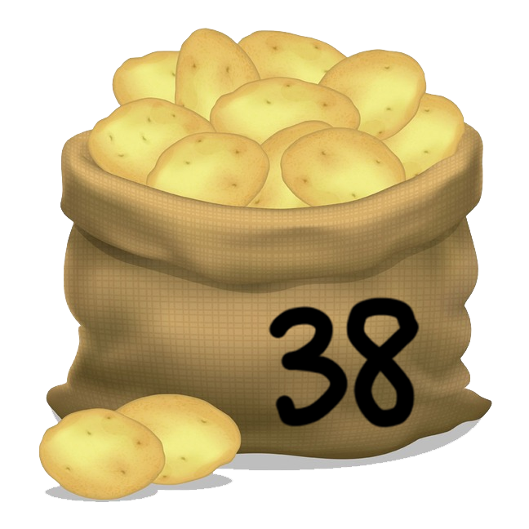
Selection Sort
Selection sort in action:

Slide 125
Selection Sort
Selection sort in action:

Slide 126
Selection Sort
Selection sort in action:

Slide 127
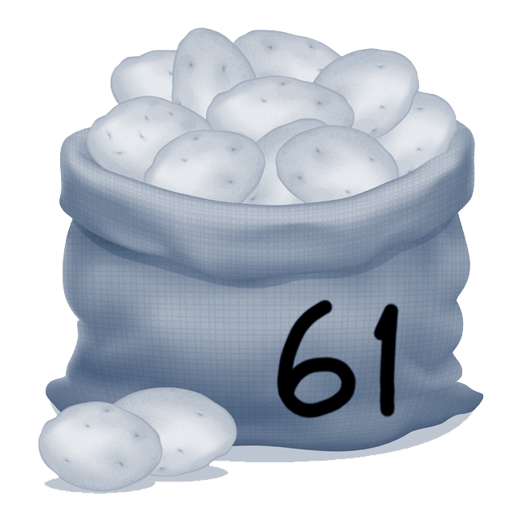
Selection Sort
Selection sort in action:

Slide 128
Selection Sort
Selection sort in action:

Slide 129
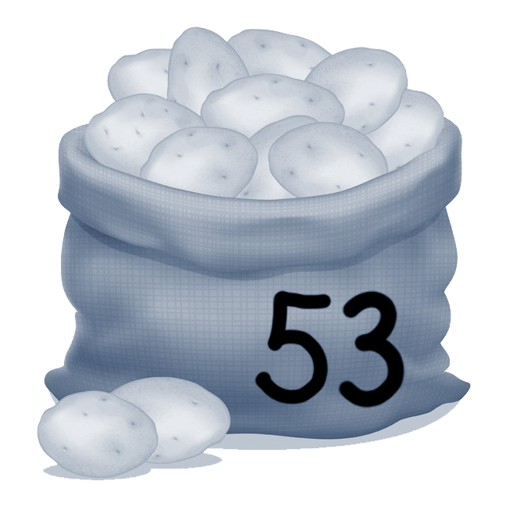
Selection Sort
Selection sort in action:

Slide 130
Selection Sort
Selection sort in action:

Slide 131
Selection Sort
Selection sort in action:

Slide 132
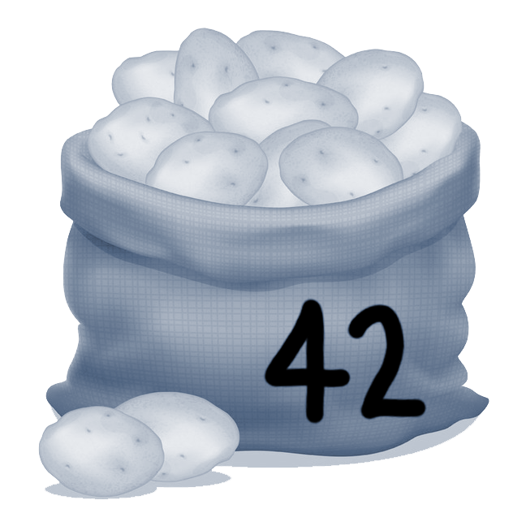
Selection Sort
Selection sort in action:

Slide 133
Selection Sort
Selection sort in action:

Slide 134
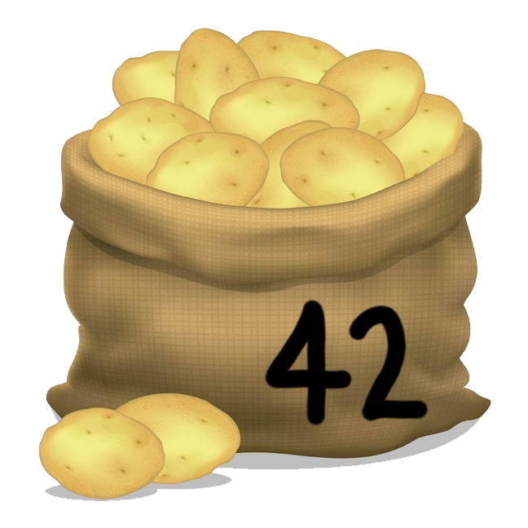
Selection Sort
Selection sort in action:

Slide 135
Selection Sort
Selection sort in action:

Slide 136
Selection Sort
Selection sort in action:

Slide 137
Selection Sort
Selection sort in action:

Slide 138
Selection Sort
Selection sort in action:

Slide 139
Selection Sort
Selection sort in action:

Slide 140
Selection Sort
Selection sort in action:
NOTE: here, selection sort is not stable! The current 53 was actually after the other 53 prior to sorting, but after the sort, it will come before the other 53.

Slide 141
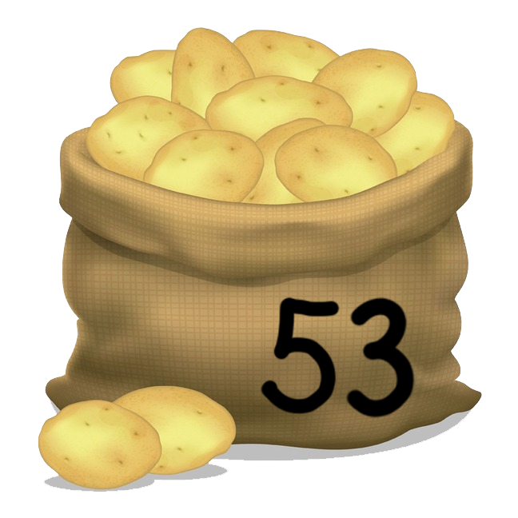
Selection Sort
Selection sort in action:
NOTE: here, selection sort is not stable! The current 53 was actually after the other 53 prior to sorting, but after the sort, it will come before the other 53.

Slide 142
Selection Sort
Selection sort in action:

Slide 143
Selection Sort
Selection sort in action:

Slide 144
Selection Sort
Selection sort in action:

Slide 145
Selection Sort
Selection sort in action:

Slide 146
Selection Sort
Selection sort in action:

Slide 147
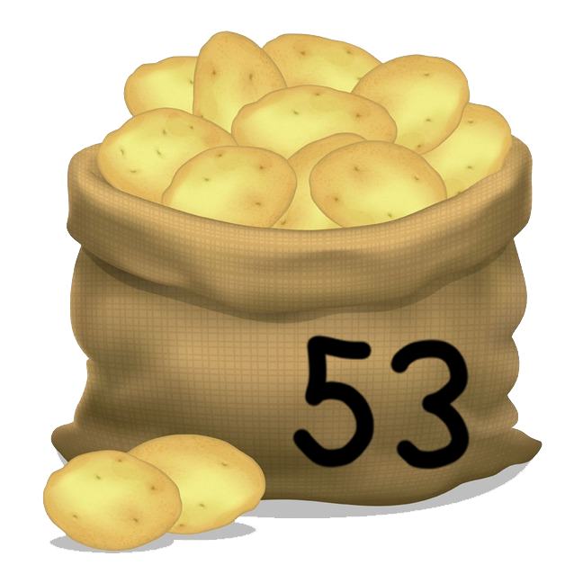
Selection Sort
Selection sort in action:

Slide 148
Selection Sort
Selection sort in action:

Slide 149
Selection Sort
Selection sort in action:

Slide 150
Selection Sort
Selection sort in action:

Slide 151
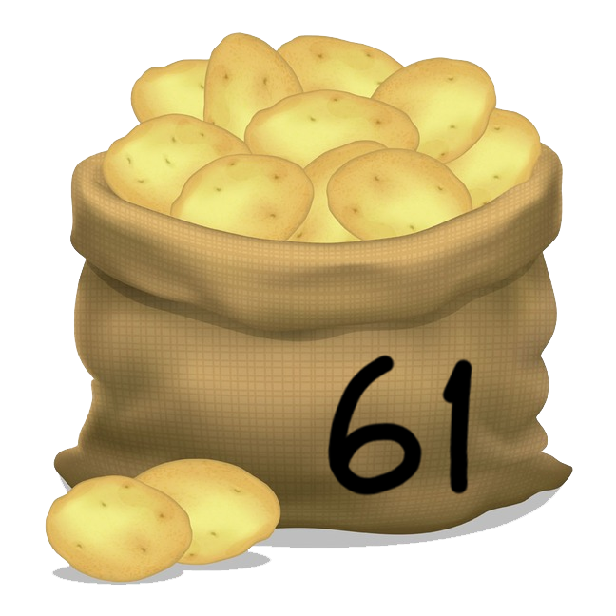
Selection Sort
Selection sort in action:

Slide 152
Selection Sort
Selection sort in action:

Slide 153
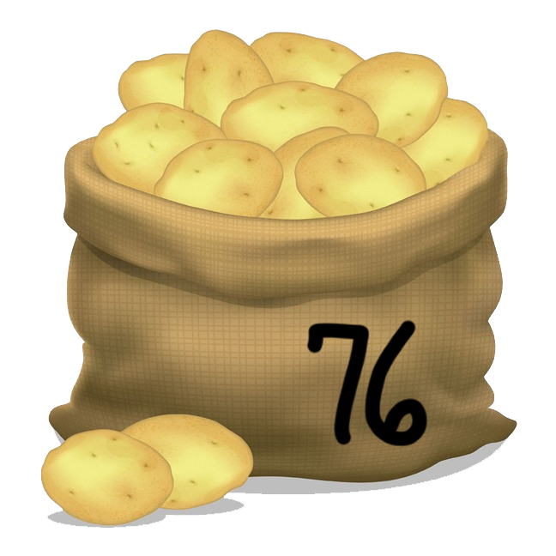
Selection Sort
Selection sort in action:

Slide 154
Insertion Sort

Slide 155
Insertion Sort
Characteristics of insertion sort:
Very efficient on “almost” sorted list!
One of the fastest sorting algorithms on small input sizes.
Algorithm: take each item and “insert” it into the correct location when only considering all elements before it (i.e. swap left until it is where it belongs).
Best Case | Average Case | Worst Case | Memory | Stable?
Ω(n) | Θ(n²) | O(n²) | O(1) | Yes

Slide 156
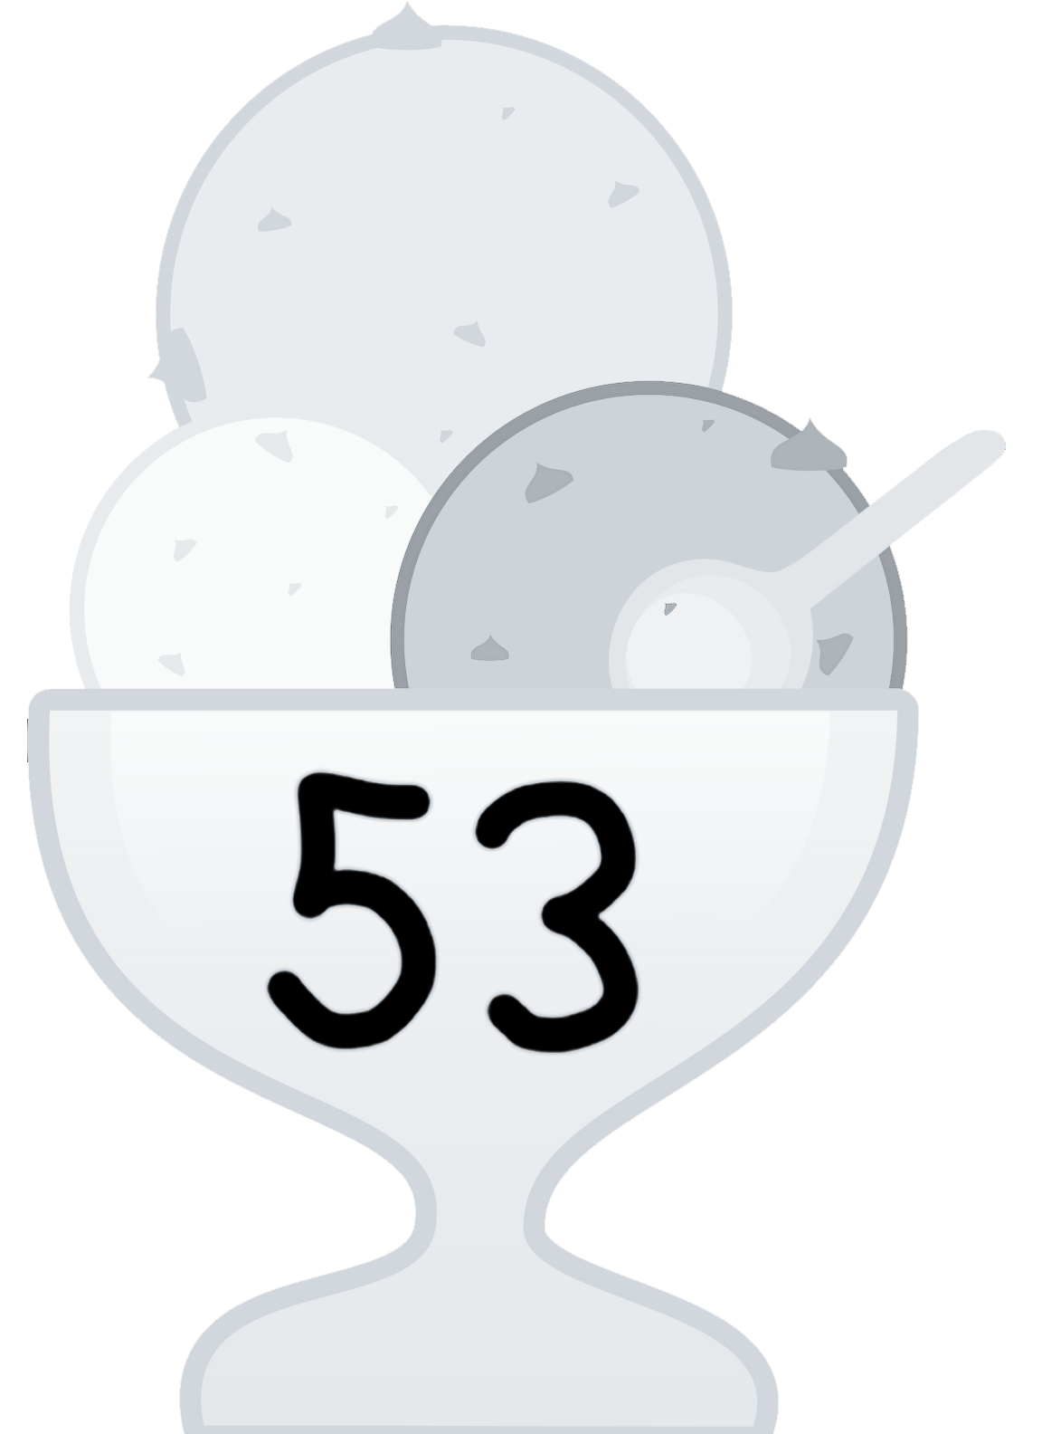
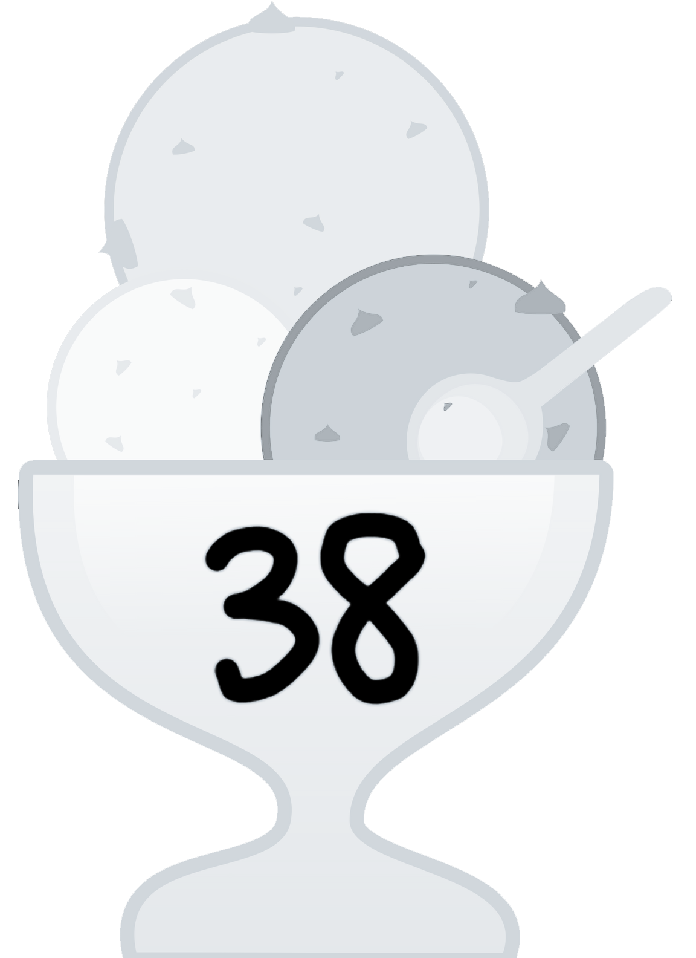
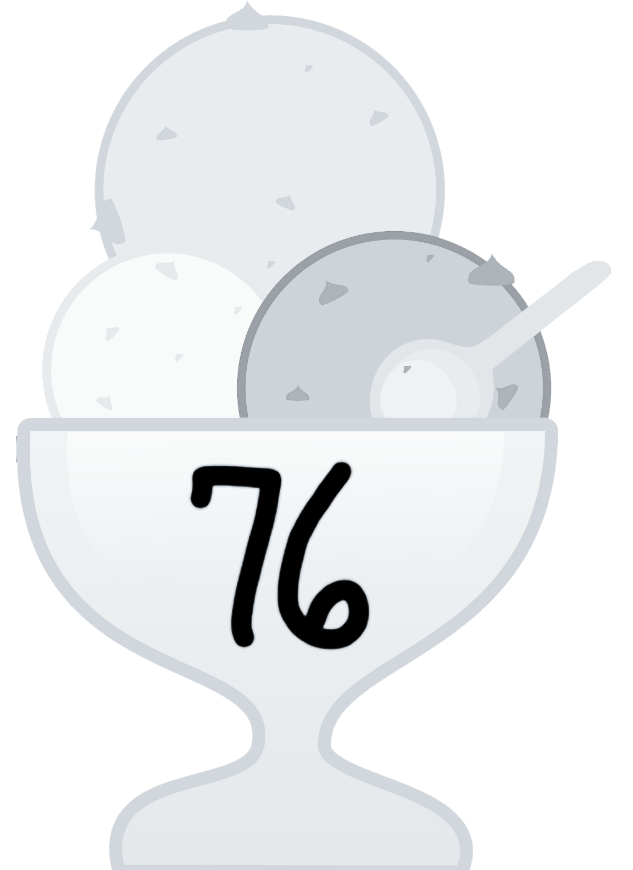
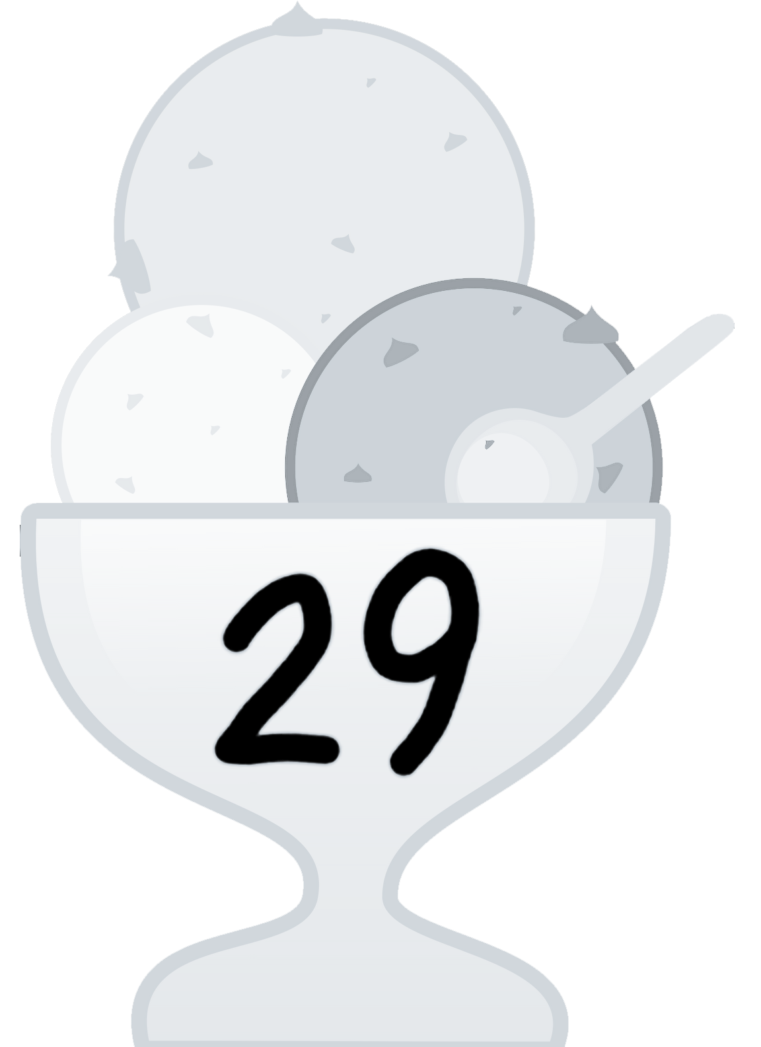


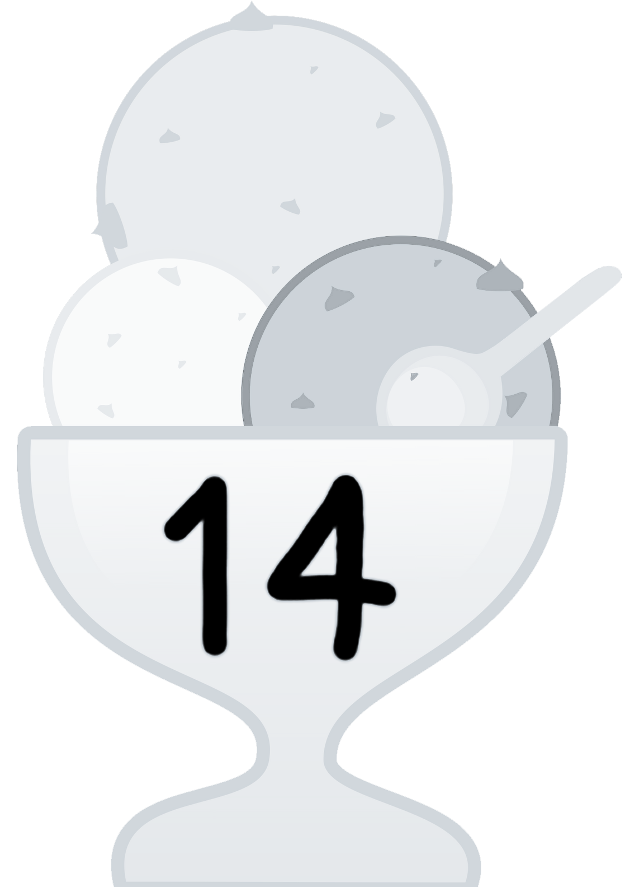

Insertion Sort
Insertion sort in action:

Slide 157

Insertion Sort
Insertion sort in action:

Slide 158
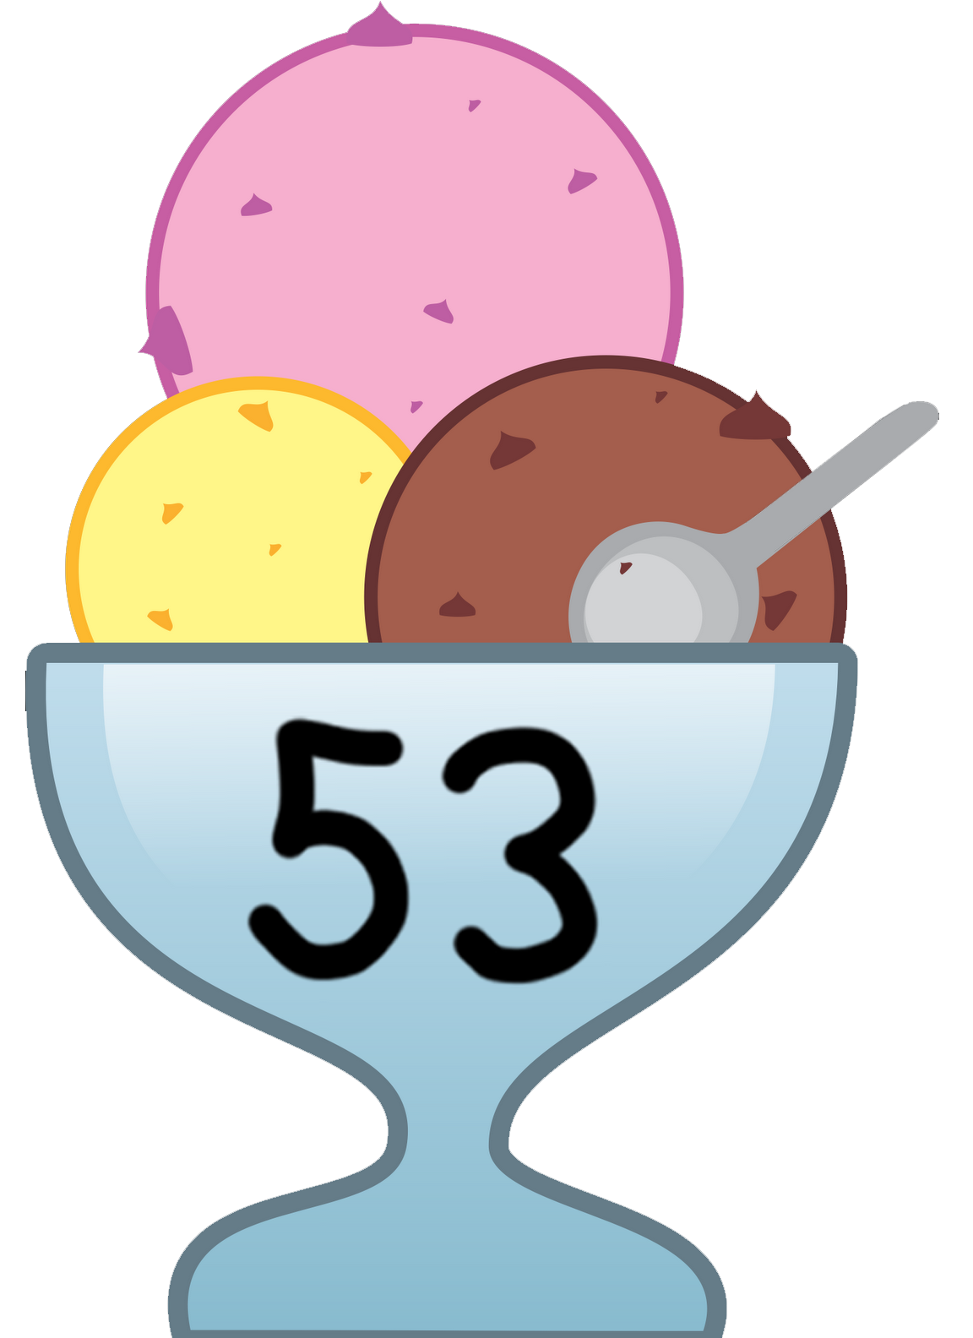
Insertion Sort
Insertion sort in action:

Slide 159

Insertion Sort
Insertion sort in action:

Slide 160
Insertion Sort
Insertion sort in action:

Slide 161

Insertion Sort
Insertion sort in action:

Slide 162

Insertion Sort
Insertion sort in action:

Slide 163

Insertion Sort
Insertion sort in action:

Slide 164

Insertion Sort
Insertion sort in action:

Slide 165
Insertion Sort
Insertion sort in action:

Slide 166
Insertion Sort
Insertion sort in action:

Slide 167
Insertion Sort
Insertion sort in action:

Slide 168
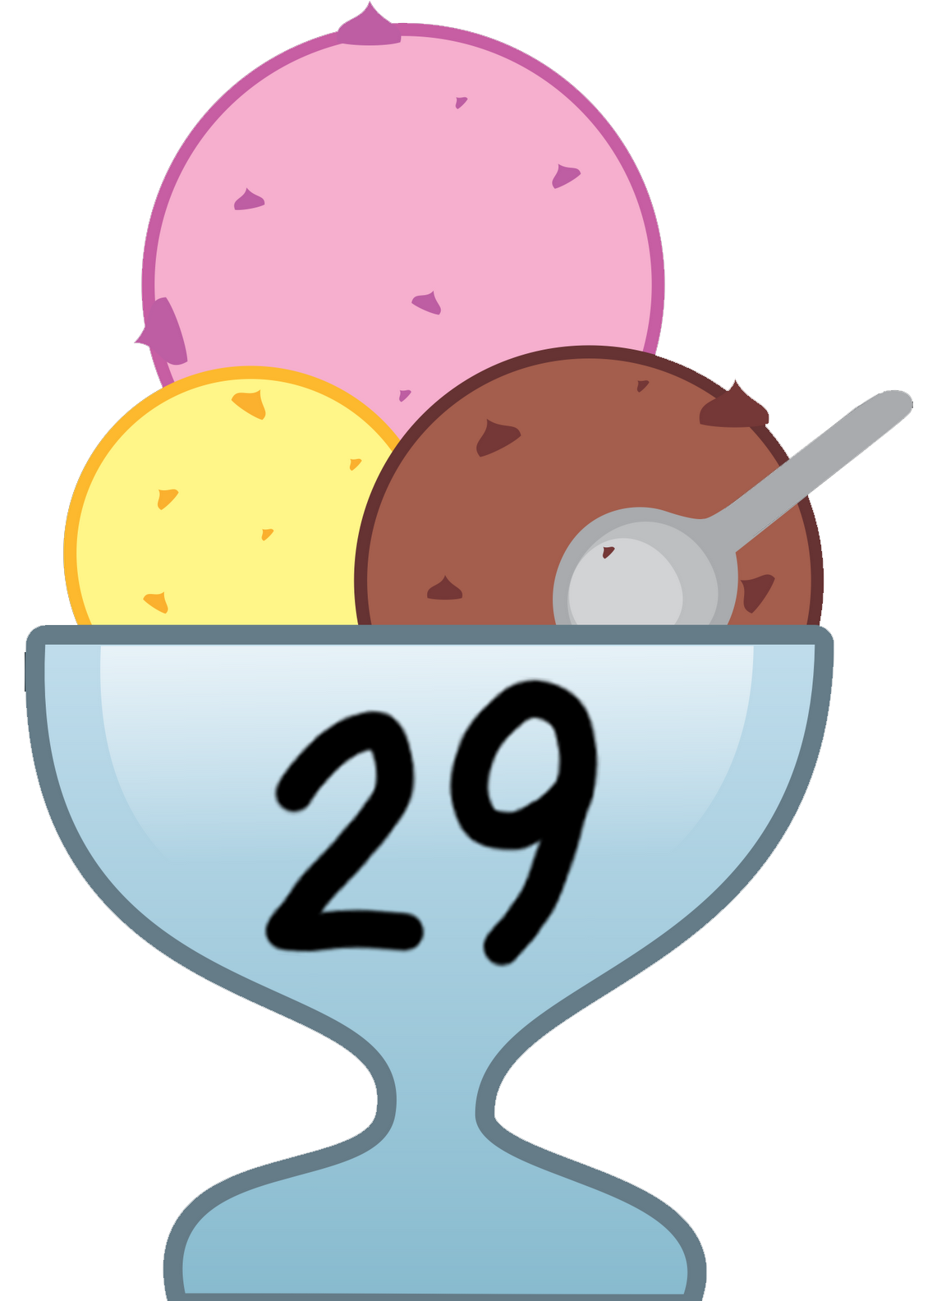
Insertion Sort
Insertion sort in action:

Slide 169

Insertion Sort
Insertion sort in action:

Slide 170
Insertion Sort
Insertion sort in action:

Slide 171
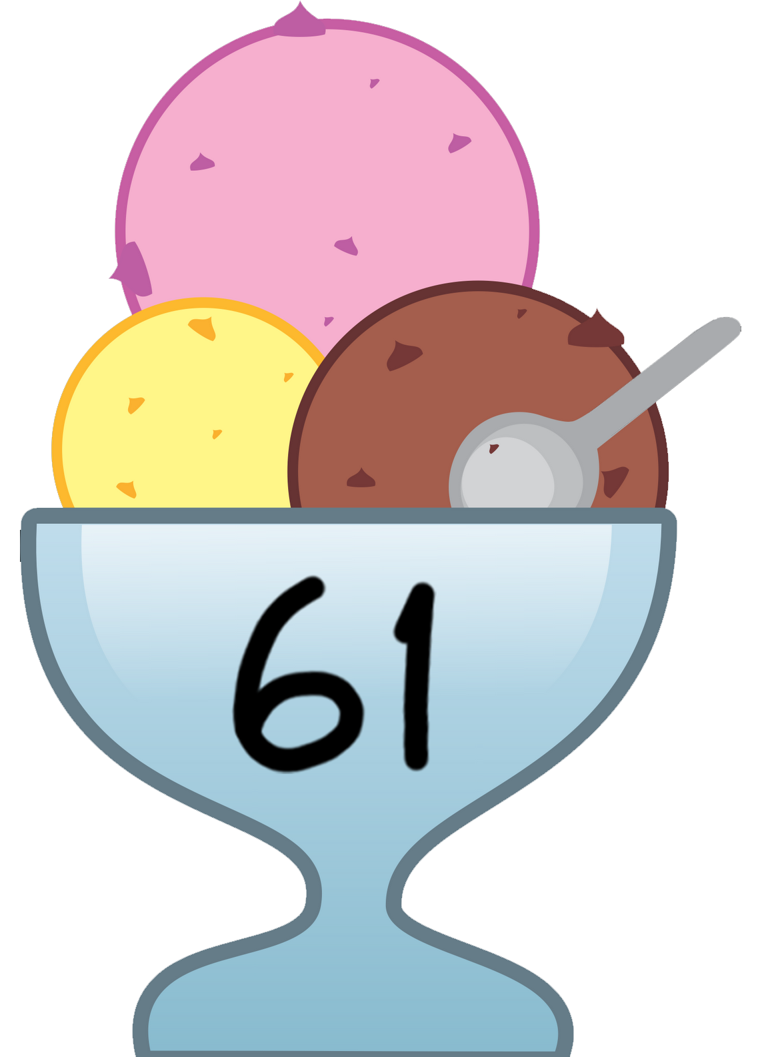
Insertion Sort
Insertion sort in action:

Slide 172

Insertion Sort
Insertion sort in action:

Slide 173
Insertion Sort
Insertion sort in action:

Slide 174
Insertion Sort
Insertion sort in action:

Slide 175
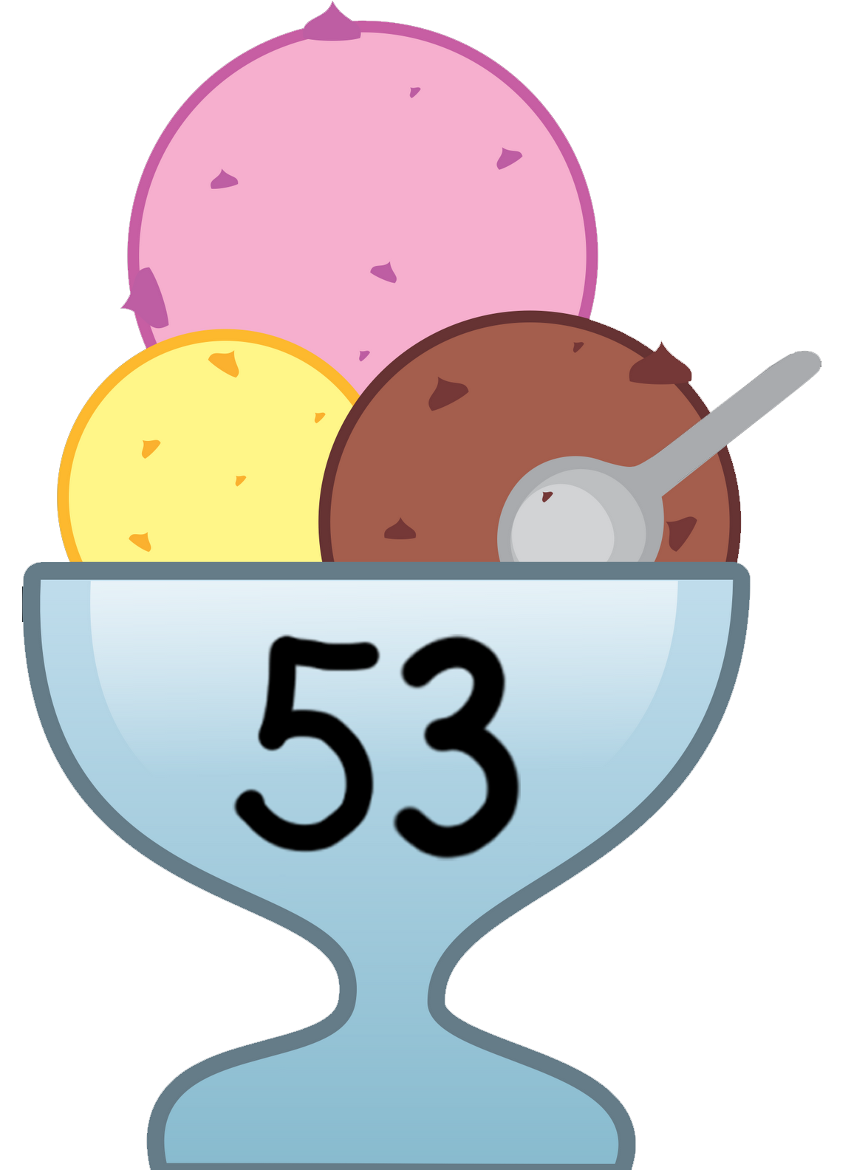
Insertion Sort
Insertion sort in action:

Slide 176

Insertion Sort
Insertion sort in action:

Slide 177
Insertion Sort
Insertion sort in action:

Slide 178
Insertion Sort
Insertion sort in action:

Slide 179
Insertion Sort
Insertion sort in action:

Slide 180
Insertion Sort
Insertion sort in action:

Slide 181
Insertion Sort
Insertion sort in action:

Slide 182
Insertion Sort
Insertion sort in action:

Slide 183

Insertion Sort
Insertion sort in action:

Slide 184
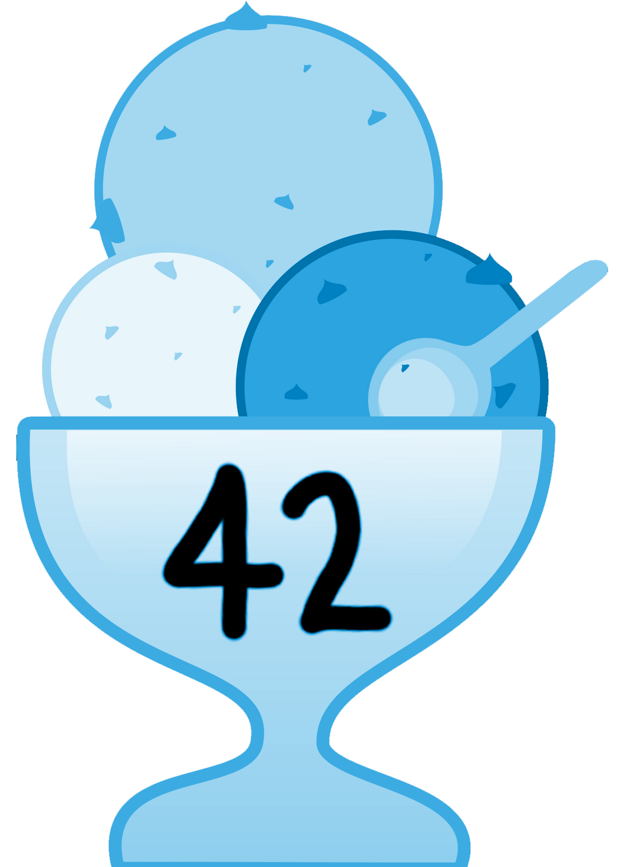
Insertion Sort
Insertion sort in action:

Slide 185
Insertion Sort
Insertion sort in action:

Slide 186
Insertion Sort
Insertion sort in action:

Slide 187
Insertion Sort
Insertion sort in action:

Slide 188
Insertion Sort
Insertion sort in action:

Slide 189
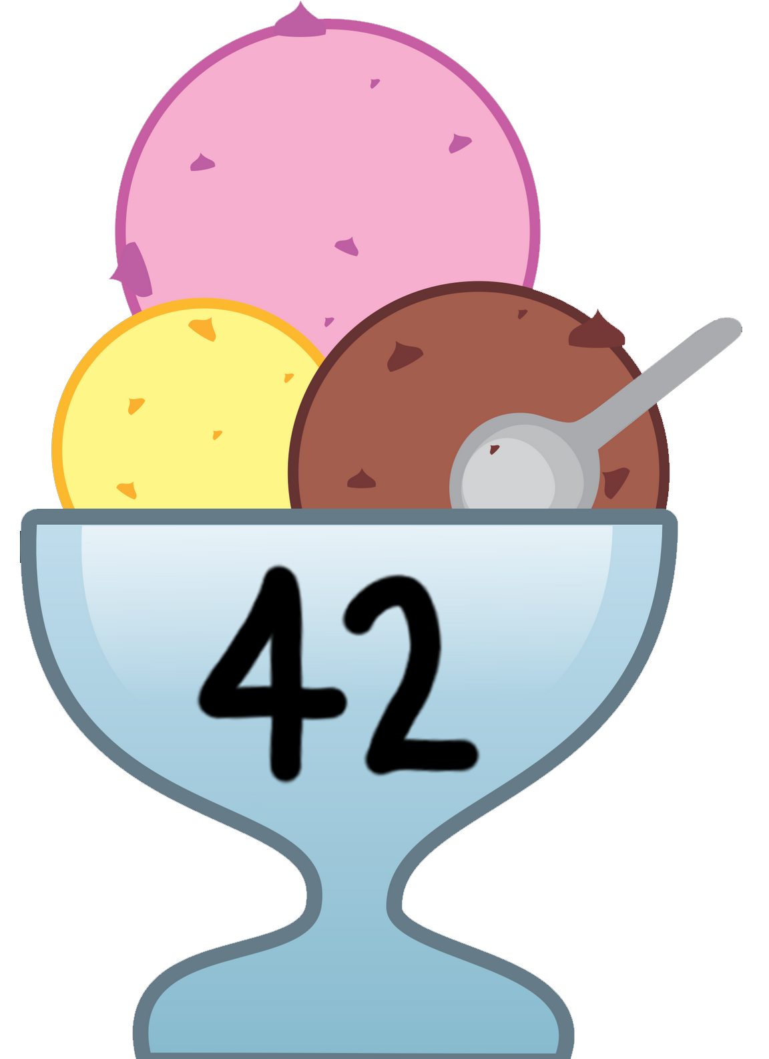
Insertion Sort
Insertion sort in action:

Slide 190
Merge Sort

Slide 191
Merge Sort (Top Down)
Take a list, split it in half
Recursively sort both halves
Combine halves with merge function
Base case occurs when halves have length 1

Slide 192
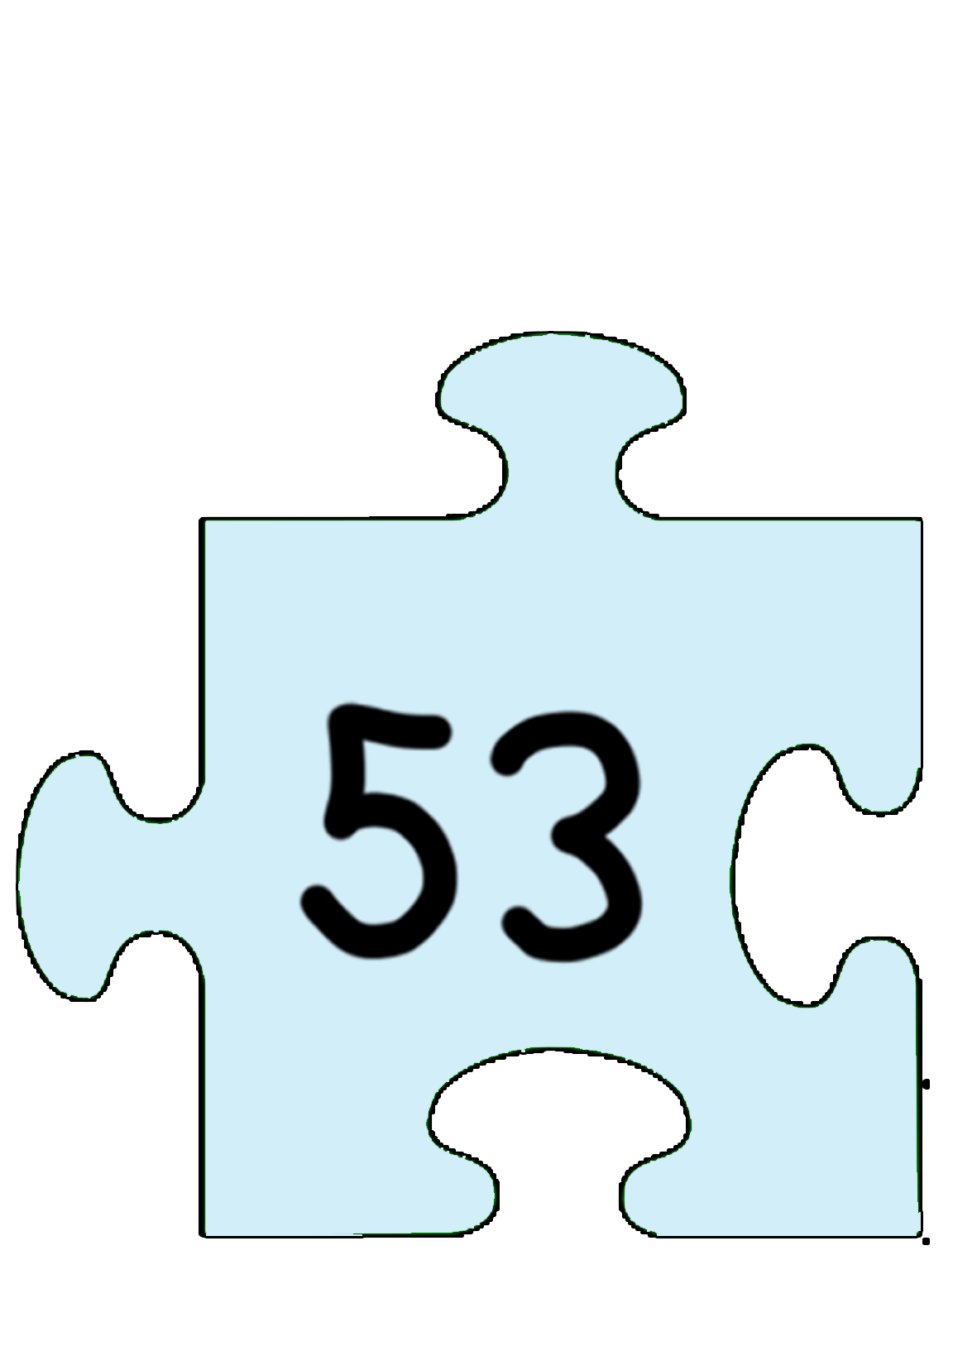
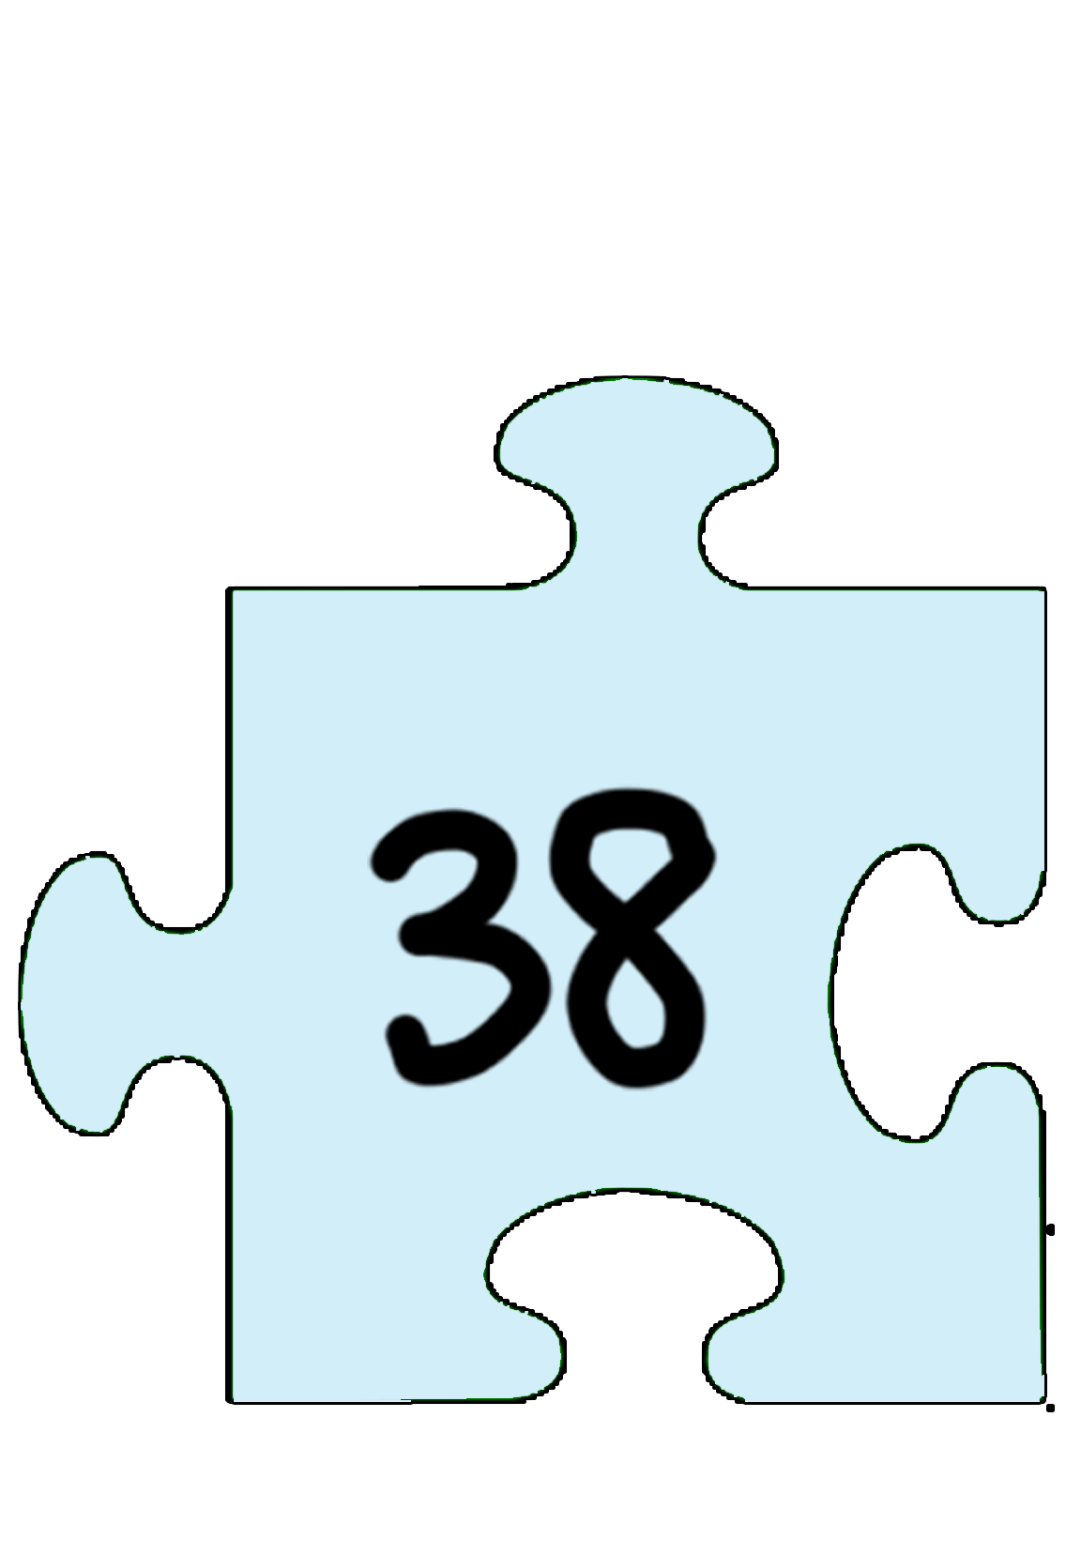
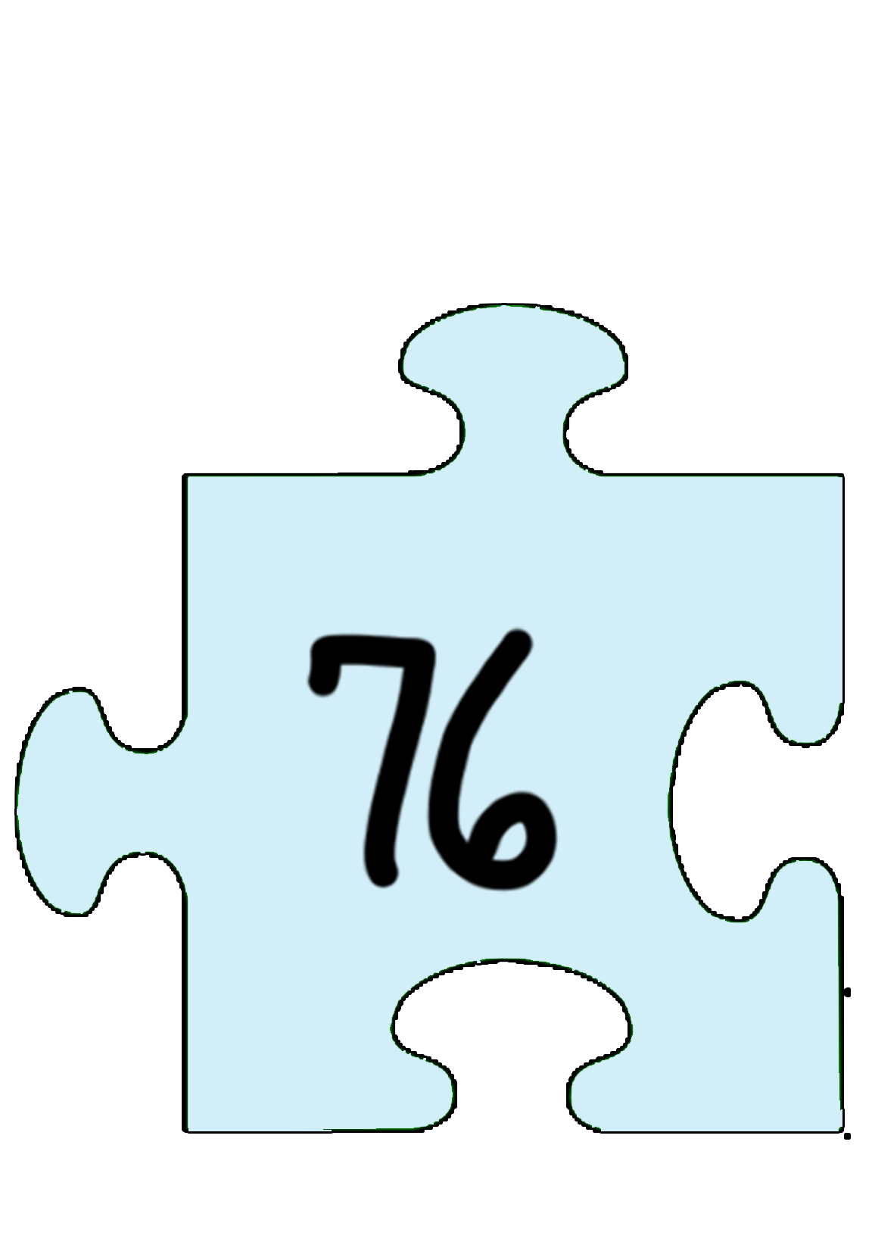
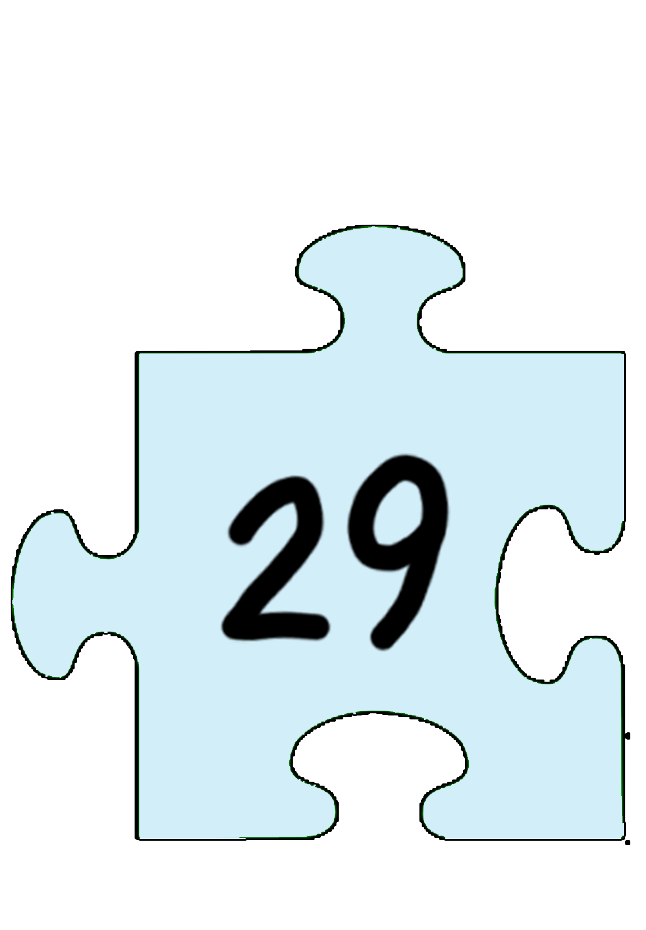




Merge Sort (Top Down)
Merge sort in action:

Slide 193








Merge Sort (Top Down)
Merge sort in action:

Slide 194
Merge Sort (Top Down)
Merge sort in action:

Slide 195
Merge Sort (Top Down)
Merge sort in action:

Slide 196
Merge Sort (Top Down)
Merge sort in action:

Slide 197


Merge Sort (Top Down)
Merge sort in action:

Slide 198
Merge Sort (Top Down)
Merge sort in action:

Slide 199
Merge Sort (Top Down)
Merge sort in action:

Slide 200


Merge Sort (Top Down)
Merge sort in action:

Slide 201
Merge Sort (Top Down)
Merge sort in action:

Slide 202
Merge Sort (Top Down)
Merge sort in action:

Slide 203


Merge Sort (Top Down)
Merge sort in action:

Slide 204
Merge Sort (Top Down)
Merge sort in action:

Slide 205
Merge Sort (Top Down)
Merge sort in action:

Slide 206


Merge Sort (Top Down)
Merge sort in action:

Slide 207
Merge Sort (Top Down)
Merge sort in action:

Slide 208
Merge Sort (Top Down)
Merge sort in action:

Slide 209
Merge Sort (Top Down)
Merge sort in action:

Slide 210
Merge Sort (Top Down)
Merge sort in action:

Slide 211
Merge Sort (Top Down)
Merge sort in action:

Slide 212
Merge Sort (Top Down)
Merge sort in action:

Slide 213
Merge Sort (Top Down)
Merge sort in action:

Slide 214
Merge Sort (Top Down)
Merge sort in action:

Slide 215
Merge Sort (Top Down)
Merge sort in action:

Slide 216
Merge Sort (Top Down)
Merge sort in action:

Slide 217
Merge Sort (Top Down)
Merge sort in action:

Slide 218
Merge Sort (Top Down)
Merge sort in action:

Slide 219
Merge Sort (Top Down)
Merge sort in action:

Slide 220
Merge Sort (Top Down)
Merge sort in action:

Slide 221
Merge Sort (Top Down)
Merge sort in action:

Slide 222
Merge Sort (Top Down)
Merge sort in action:

Slide 223
Merge Sort (Top Down)
Merge sort in action:

Slide 224
Merge Sort (Top Down)
Merge sort in action:

Slide 225
Merge Sort (Top Down)
Merge sort in action:

Slide 226
Merge Sort (Top Down)
Merge sort in action:

Slide 227
Merge Sort (Top Down)
Merge sort in action:

Slide 228
Merge Sort (Top Down)
Merge sort in action:

Slide 229
Merge Sort (Top Down)
Merge sort in action:

Slide 230
Merge Sort (Top Down)
Merge sort in action:

Slide 231
Merge Sort (Top Down)
Merge sort in action:

Slide 232








Merge Sort (Top Down)
Merge sort in action:

Slide 233

Merge Sort Complexity Analysis
mergesort(int [] a, int left, int right) {
if (right > left) {
middle = left + (right - left)/2;
mergesort(a, left, middle);
mergesort(a, middle+1, right);
merge(a, left, middle, right);
}
return;
}
T(n) = time to sort left half + time to sort right half + time to merge halves
= T(n/2) + T(n/2) + n
Therefore, we have: T(n) = 2 * T(n/2) + n, T(1) = 1

Slide 234
Merge Sort Complexity Analysis
mergesort(int [] a, int left, int right) {
if (right > left) {
middle = left + (right - left)/2;
mergesort(a, left, middle);
mergesort(a, middle+1, right);
merge(a, left, middle, right);
}
return;
}
By the Master Theorem, the complexity is Θ(n log n).
T(n) = time to sort left half + time to sort right half + time to merge halves
= T(n/2) + T(n/2) + n
Therefore, we have: T(n) = 2 * T(n/2) + n, T(1) = 1

Slide 235
Merge Sort
Characteristics of merge sort:
Comparison-based, divide-and-conquer algorithm.
Bottom-up and top-down algorithms available.
Algorithm: divide unsorted list into n sublists, each containing 1 element. Repeatedly merge sublists to produce new sublists until there is only one sublist (the final sorted list) left.
Stable as long as merge is stable. Not adaptive.
Memory is O(n) worst-case because most implementations merge into a separate container and then copy over to the original container.
Best Case | Average Case | Worst Case | Memory | Stable?
Ω(n log n) | Θ(n log n) | O(n log n) | O(n) | Yes

Slide 236
Quicksort

Slide 237








Quicksort
Quicksort in action (with last element as pivot):

Slide 238

Quicksort
Quicksort in action (with last element as pivot):
L
R

Slide 239

Quicksort
Quicksort in action (with last element as pivot):
L
> 42
R

Slide 240

Quicksort
Quicksort in action (with last element as pivot):
L
> 42
R
< 42

Slide 241
Quicksort
Quicksort in action (with last element as pivot):
L
R

Slide 242
Quicksort
Quicksort in action (with last element as pivot):
L
R

Slide 243
Quicksort
Quicksort in action (with last element as pivot):
L
< 42
R

Slide 244

Quicksort
Quicksort in action (with last element as pivot):
L
> 42
R

Slide 245
Quicksort
Quicksort in action (with last element as pivot):
L
> 42
R
> 42

Slide 246
Quicksort
Quicksort in action (with last element as pivot):
L
> 42
R
> 42

Slide 247

Quicksort
Quicksort in action (with last element as pivot):
L
> 42
R
< 42

Slide 248
Quicksort
Quicksort in action (with last element as pivot):
L
R

Slide 249
Quicksort
Quicksort in action (with last element as pivot):
L
R

Slide 250
Quicksort
Quicksort in action (with last element as pivot):
R
L
left and right are equal… swap with the pivot!

Slide 251

Quicksort
Quicksort in action (with last element as pivot):

Slide 252
Quicksort
Quicksort in action (with last element as pivot):

Slide 253


Quicksort
Quicksort in action (with last element as pivot):
now you partition and run quicksort on the elements
to the left of the pivot (and after this is done, you would quicksort the elements to the right of the pivot)
notice that 42 is now in the correct position

Slide 254
Quicksort — Choosing a different initial pivot
Suppose we wanted to pick a different pivot that more evenly partitions the array, such as the middle.
How can we incorporate this new pivot into our algorithm?
L
R

Slide 255
Quicksort — Choosing a different initial pivot
Suppose we wanted to pick a different pivot that more evenly partitions the array.
How can we incorporate this new pivot into our algorithm?
Swap our new pivot with the last element, and proceed as before!
L
R

Slide 256
Quicksort
Characteristics of quicksort:
Comparison-based sorting algorithm.
Most implementations are unstable, except for complex in-place partitioning.
Often faster in practice than other n log n sorting algorithms.
Algorithm: pick a pivot from the list. Reorder list so that elements with values less than the pivot come before the pivot, while elements with values greater than or equal to the pivot come after it. After partitioning, the pivot is in the final position. Recursively sort the sub-list of elements with smaller values and the sub-list of elements with greater values.
Best Case | Average Case | Worst Case | Memory | Stable?
Ω(n log n) | Θ(n log n) | O(n²) | O(log n) | No*

Slide 257
Quicksort
What causes the worst-case O(n²) behavior?
What is the ideal pivot choice?
Why can’t we do this? What can we do instead?

Slide 258
Quicksort
What causes the worst-case O(n²) behavior?
When the smallest or largest element is chosen as the pivot every
time (the more uneven the partition, the worse the performance).
What is the ideal pivot choice?
Why can’t we do this? What can we do instead?

Slide 259
Quicksort
What causes the worst-case O(n²) behavior?
When the smallest or largest element is chosen as the pivot every
time (the more uneven the partition, the worse the performance).
What is the ideal pivot choice?
The median element (most evenly partitions the array - roughly equal
number of elements to both left and right of pivot).
Why can’t we do this? What can we do instead?

Slide 260
Quicksort
What causes the worst-case O(n²) behavior?
When the smallest or largest element is chosen as the pivot every
time (the more uneven the partition, the worse the performance).
What is the ideal pivot choice?
The median element (most evenly partitions the array - roughly equal
number of elements to both left and right of pivot.
Why can’t we do this? What can we do instead?
The median is often hard to find. To solve this, we can use median
sampling instead (e.g. take the median of a sample).

Slide 261
Summary of Sorts

Slide 262
Summary
Sort | Best | Average | Worst | Memory | Stable? | Adaptive?
Bubble | Ω(n) | Θ(n²) | O(n²) | O(1) | Yes | Yes
Selection | Ω(n²) | Θ(n²) | O(n²) | O(1) | No | No
Insertion | Ω(n) | Θ(n²) | O(n²) | O(1) | Yes | Yes
Heap | Ω(n log n) (distinct keys) | Θ(n log n) | O(n log n) | O(1) | No | No
Merge | Ω(n log n) | Θ(n log n) | O(n log n) | O(n) | Yes (if merge is stable) | No
Quick | Ω(n log n) | Θ(n log n) | O(n²) | O(log n) | No | No

Slide 263
Binary Search

Slide 264

Binary Search Interview Problems
Binary search is a classic topic for interview problems.
Let’s look at a few problems that can be solved using binary search!

Slide 265
Binary Search Question #1
You are given an array that is first increasing and then decreasing. Find the maximum value of this array.
INPUT: arr[] = {8, 10, 20, 80, 100, 200, 400, 500, 3, 2, 1}
OUTPUT: 500
INPUT: arr[] = {1, 3, 50, 10, 9, 7, 6}
OUTPUT: 50
INPUT: arr[] = {10, 20, 30, 40, 50}
OUTPUT: 50
INPUT: arr[] = {120, 100, 80, 20, 0}
OUTPUT: 120

Slide 266
Binary Search Question #1
You are given an array that is first increasing and then decreasing. Find the maximum value of this array.
Solution:
perform a binary search
if middle element is greater than both of its adjacent elements, it is the maximum
if middle is greater than element to its right and smaller than element to its left, then max element lies to the left of mid (we are on decreasing side of the array)
if middle element is smaller than element to its right and greater than element to its left, then max element lies to the right of mid (we are on increasing side)

Slide 267
Binary Search Question #2
You are given a sorted array that is rotated at a certain position. Return the minimum element.
INPUT: arr[] = {5, 6, 1, 2, 3, 4}
OUTPUT: 1
INPUT: arr[] = {1, 2, 3, 4}
OUTPUT: 1
INPUT: arr[] = {2, 1}
OUTPUT: 1
INPUT: arr[] = {2, 3, 4, 5, 6, 1}
OUTPUT: 1

Slide 268
Binary Search Question #2
You are given a sorted array that is rotated at a certain position. Return the minimum element.
Solution:
perform a binary search
the minimum element is the only element whose
previous element is greater than it
check the middle element - if the element to its left is
greater than it, mid is the min
if the element to its left is less than or equal, it is not the
minimum; the minimum lies either in its left or right half
if the middle element is smaller than the last element, the
minimum lies in the left half; else, it lies in the right half
When you have narrowed the minimum down to two
elements, you can compare their values to find the min
Example:
{5, 6, 1, 2, 3, 4}
Mid element is 2. The element to the left is not greater than it. Hence, it is not the minimum.
Since 2 is smaller than 4 (the last element), it means the rotation point lies before mid. Therefore, we check the left half.

Slide 269
Binary Search Question #3
You are given a sorted array where every number occurs twice except for one number. Find this number that only appears once.
INPUT: arr[] = {1, 1, 6, 6, 9, 9, 22, 22, 26, 30, 30, 40, 40}
OUTPUT: 26
INPUT: arr[] = {1, 2, 2, 3, 3, 4, 4}
OUTPUT: 1
INPUT: arr[] = {1, 1, 2, 2, 3, 3, 4}
OUTPUT: 4
INPUT: arr[] = {281}
OUTPUT: 281

Slide 270
Binary Search Question #3
You are given a sorted array where every number occurs twice except for one number. Find this number that only appears once.
Key observation: if there were no odd element out, the first occurence of each number would be found at an even index, and the second occurrence would be found at an odd index.
This is true until we reach the odd one out! Once we reach this point, the opposite will be true (the first occurrence would be found at an odd index, the second at an even index). We will do a binary search to find the index of the odd one out.
If mid is even, check if a[mid] == a[mid + 1]
if mid is odd, check if a[mid] == a[mid - 1]
if these conditions hold, the odd one out must be found to the right, else it must be found to the left!

Slide 271
Bonus Interview Brain Teaser

Slide 272
Brain Teaser (Exercise for Home)
There are 2810 light bulbs lined up in a row in a long room. Each bulb has its own switch, and all switches are switched OFF at the beginning. The bulbs are numbered consecutively from 1 to 2810.
There are 2810 people lined up outside the entry door. Person 1 enters the room, flips the switch on every bulb, and exits. After person 1 leaves the room, person 2 enters and flips the switch on every second bulb (turning off bulbs 2, 4, 6...). After person 2 leaves, person 3 enters and flips the switch of every third bulb (changing the state on bulbs 3, 6, 9...). This continues until all 2810 people have passed through the room, where the 2810th person only flips the switch of the 2810th bulb.
After all 2810 people have exited the room, how many light bulbs are turned ON?
Suppose you have the ability to remove bulbs from the room in reverse order, first removing bulb 2810, then 2809, etc. What is the minimum number of bulbs you would have to remove for the number of bulbs that are turned ON to change?
Notes:
Answers: 53 and 2

Slide 273
Handwritten Problem

Slide 274
Handwritten Problem
Given a vector with n elements with values of either 0, 1, or 2, devise an O(n) algorithm to sort this vector. You must do this in a single pass of the vector. You may NOT copy items, create arrays or strings, or do any other memory allocation. Make sure your algorithm works for all cases.
You may use std::swap to swap two items in the vector.
BEFORE: arr[] = {2, 1, 0, 0, 2, 1, 2, 2, 0, 1, 1, 1, 0}
AFTER: arr[] = {0, 0, 0, 0, 1, 1, 1, 1, 1, 2, 2, 2, 2}
// sort a vector of 0s, 1s, and 2s in linear time
void sort012(vector<int>& nums);

Slide 275
Good Luck on the Exam!

